Slide 1
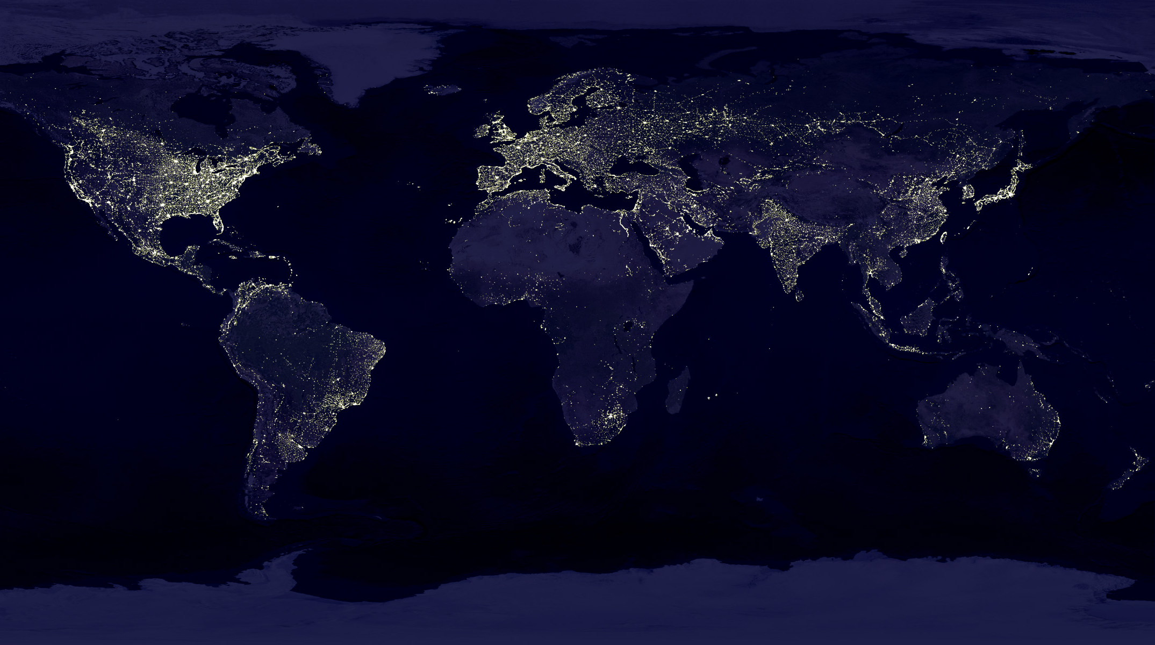
Earth System Information and Common Concerns for Humanity
Dr. Robert S. Chen Director, CIESIN, The Earth Institute, Columbia University Secretary-General, CODATA, International Council for Science Manager, NASA Socioeconomic Data and Applications Center

Slide 2
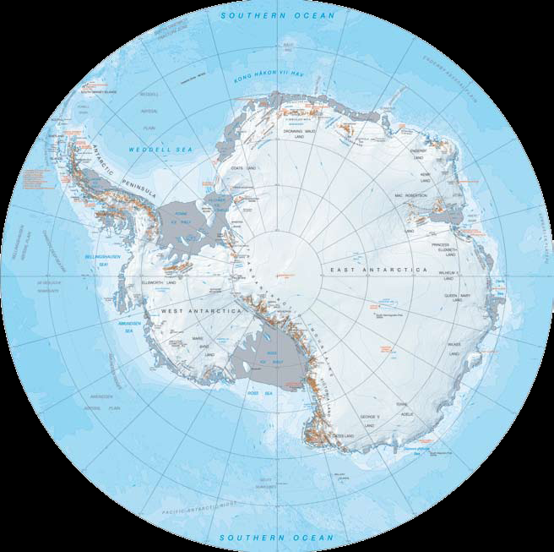
The Antarctic Treaty not only established a physical commons but also an “information commons”
Article IIIc: “…to the greatest extent feasible and practicable…scientific observations and results from Antarctica shall be exchanged and made freely available.

Slide 3
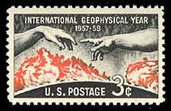
Another major legacy of the IGY was the ICSU World Data Center System
WDC Principles: Full and Open Access to Data
“WDCs will provide data to scientists in any country free of charge or at a cost not to exceed the cost of copying and sending the requested data.
“WDCs operate … for the benefit of the international scientific community and provide a mechanism for international exchange of data in all disciplines related to the Earth, its environment, and the Sun.”

Slide 4
The WDCs began as “bricks & mortar” centers but are now evolving into a “virtual” World Data System addressing science & development
Marine geology
& geophysics
Meteorology
Oceanography
Rockets & satellites & Rotation of the Earth
Solar-terrestrial physics
Solid-earth geophysics
Airglow
Aurora
Cosmic rays
Geomagnetism
Ionosphere
Radioactivity
Solar radio emission
Space science satellites
Earth tides
Geomagnetism (2)
Glaciology
Recent crustal movements
Solar activity
Solar-terrestrial physics
Sunspot index
Glaciology
Meteorology
Marine geology & geophysics
& Solid-earth geophysics
Oceanography
Rockets & Satellites
Rotation of the Earth
Solar-terrestrial physics
Seismology
Soils
Geoinformatics & Sustainable Development
Marine environmental science
Atmosphere remote sensing
Climate
Geomagnetism
Astronomy
Geology
Geophysics
Glaciology & Geocryology
Meteorology
Oceanography
Renewable Resources
Seismology
Space Science
Biodiversity and Human Health
Atmospheric trace gases
Remotely sensed land data
Paleoclimatology
Human interactions in the environment
Land cover
Solar-terrestrial science
Biodiversity & ecology

Slide 5
The International Polar Year (IPY) , 2007-2008, promoted open access to scientific data and information about the Earth’s polar regions
IPY Data Policy
“…in order to maximize the benefit of data gathered under the auspices of the IPY, the IPY Joint Committee requires that IPY data, including operational data delivered in real time, are made available fully, freely, openly, and on the shortest feasible timescale.”
Exceptions relate to confidentiality, local and traditional knowledge, protection of sensitive areas and species

Slide 6
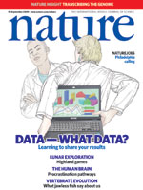
The norms for data sharing are also evolving in the scientific community
ICSU Principle of Universality of Science
Statute 5: “This principle embodies freedom of movement, association, expression and communication for scientists, as well as equitable access to data, information and research materials.”
“Research cannot flourish if data are not preserved and made accessible.” – Editorial, Nature, 2009
http://tinyurl.com/dataspecial

Slide 7
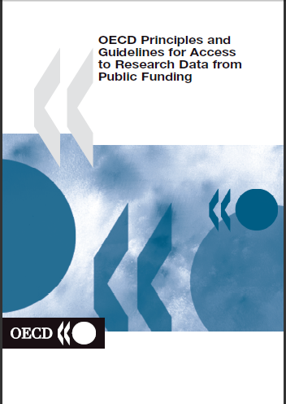
OECD Principles and Guidelines for Access to Research Data from Public Funding
Principle A: Openness
“Openness means access on equal terms for the international research community at the lowest possible cost, preferably at no more than the marginal cost of dissemination. Open access to research data from public funding should be easy, timely, user-friendly and preferably Internet-based.” – OECD, 2007
http://www.oecd.org/dataoecd/9/61/38500813.pdf

Slide 8
Why are open data and science so important?
Climate changes are already having measurable impacts at the regional scale around the world.

Slide 9
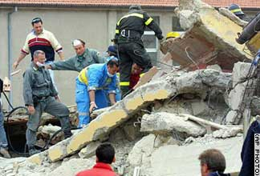
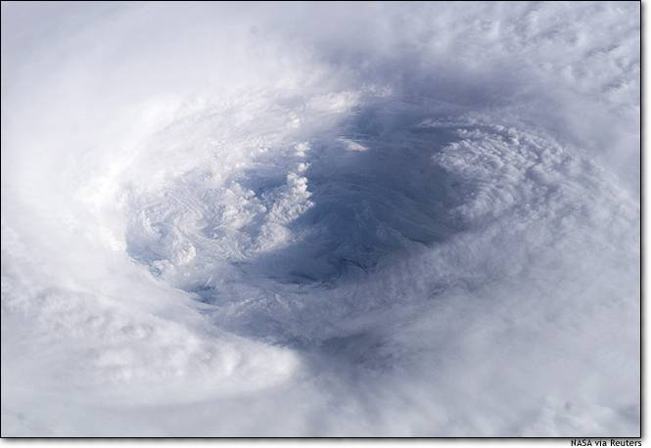
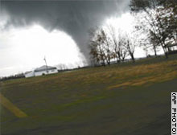
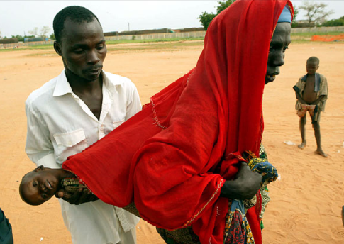
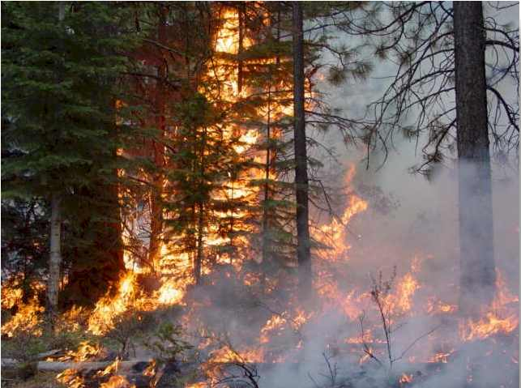
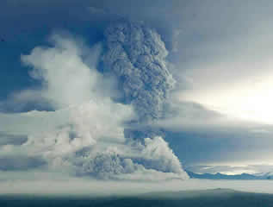
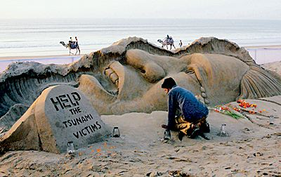
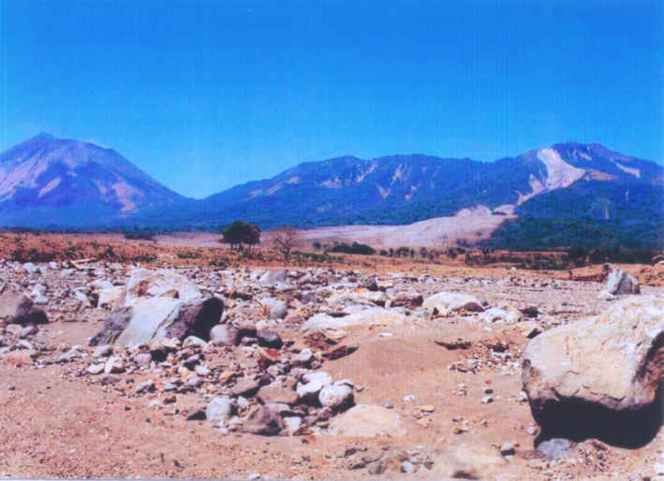
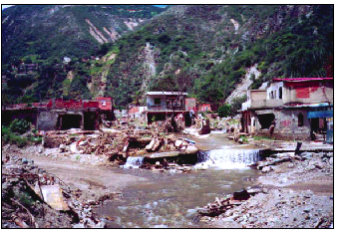
Hazards—both natural and human-induced—remain diverse, complex, and dangerous
Drought
Floods
Severe storms
Cyclones/hurricanes
Landslides
Wildfires
Heat waves
Cold waves
Earthquakes
Volcanoes
Tsunamis
Conflict
Disease
Accidents
Pollution
The Casita slide

Slide 10
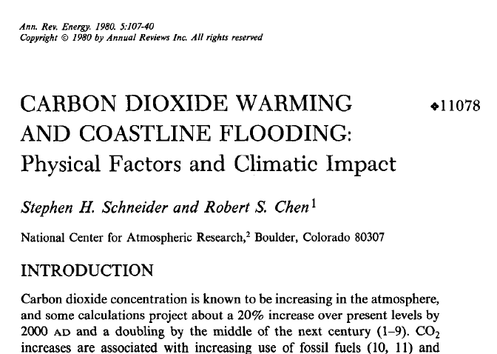
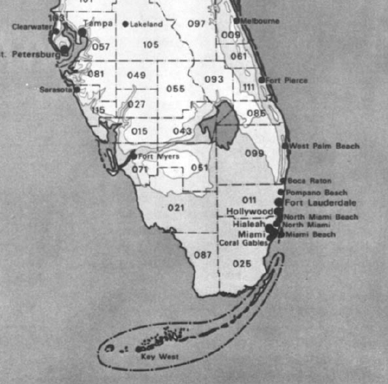
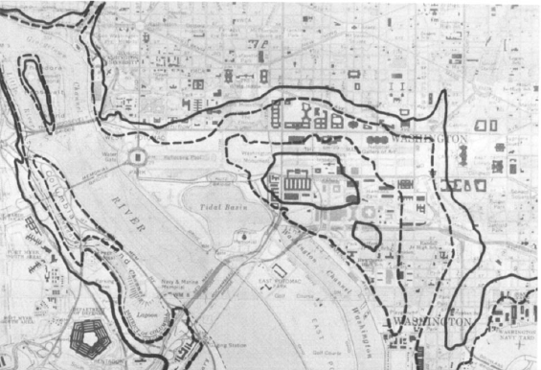
How would sea level rise affect coastlines?
Potential impacts of 5- to 8-m rise on southern Florida and Washington DC, estimated in 1980

Slide 11
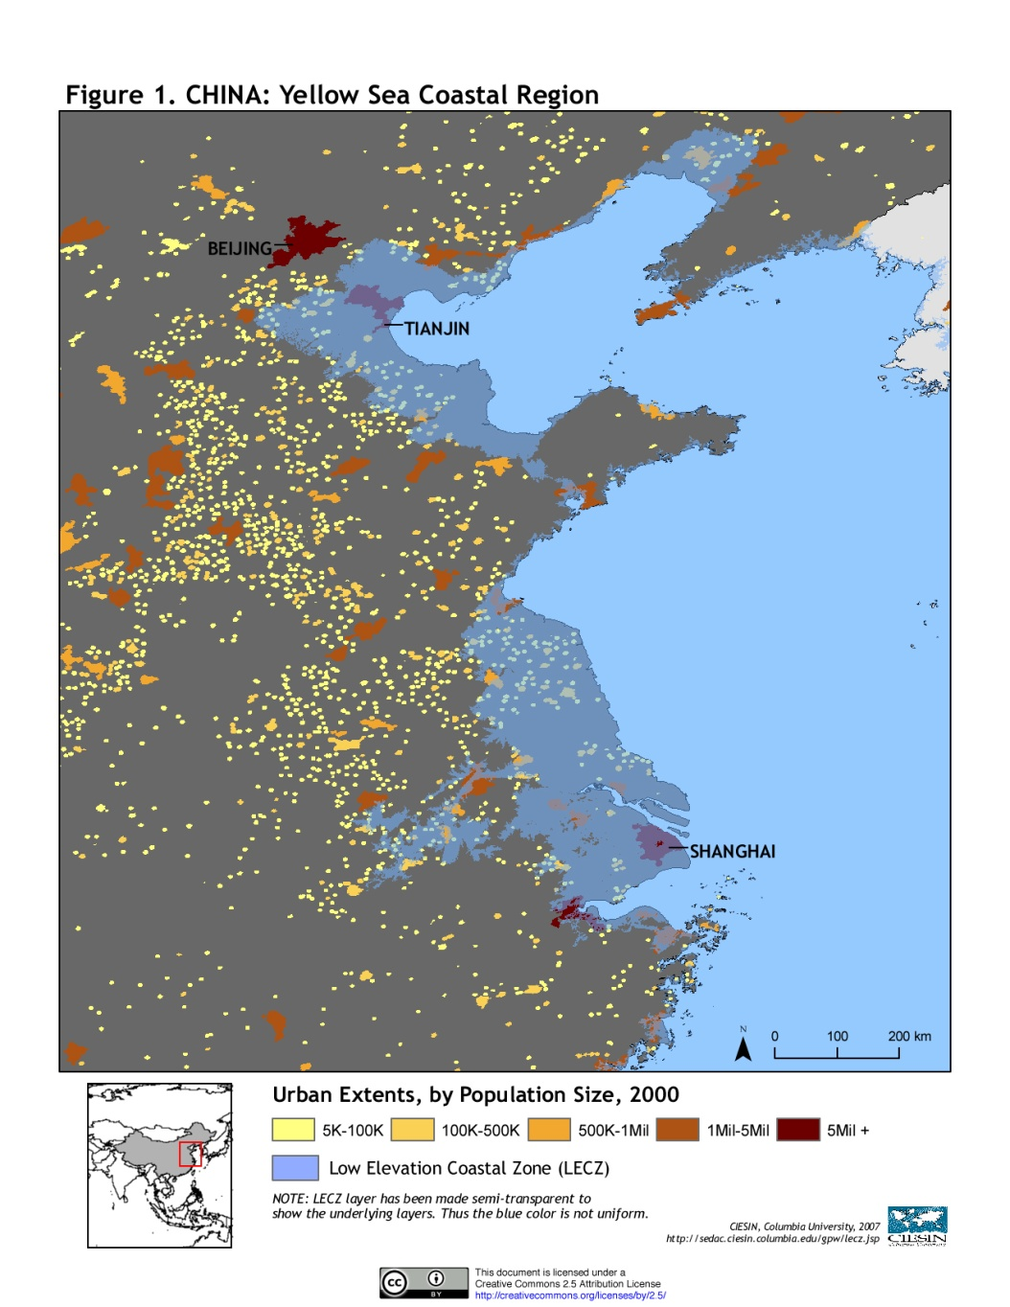
CIESIN Low Elevation Coastal Zone Dataset

Slide 12
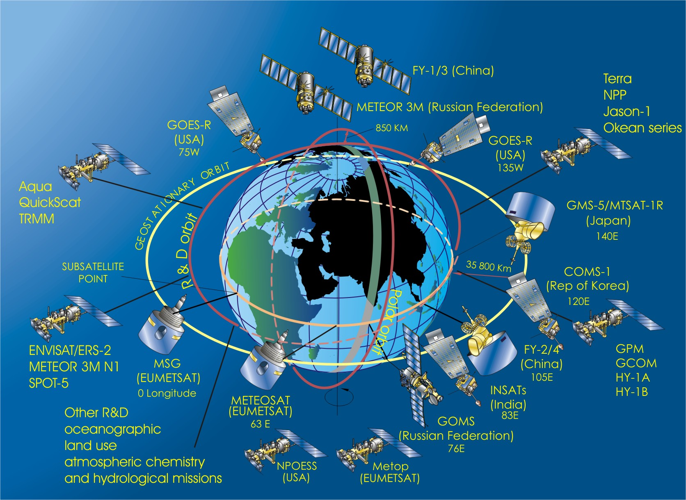
How can we improve governance of international cyberspace, e.g., for Earth observations?

Slide 13
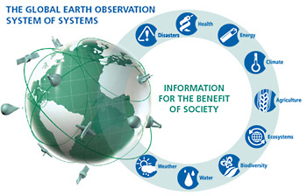
The Group on Earth Observations (GEO) is a major voluntary intergovernmental \initiative to develop an interoperable “Global Earth Observation System of Systems” (GEOSS)
GEO currently has 80 national members plus the European Commission and more than 50 participating organizations

Slide 14
The agreed GEO Data Sharing Principles are an important step towards wider global access
“The societal benefits of Earth observations cannot be achieved without data sharing.”
There will be full and open exchange of data, metadata, and products shared within GEOSS, recognizing relevant international instruments and national policies and legislation.
All shared data, metadata, and products will be made available with minimum time delay and at minimum cost.
All shared data, metadata, and products being free of charge or no more than cost of reproduction will be encouraged for research and education.
GEOSS 10-Year Implementation Plan, adopted 16 February 2005

Slide 15
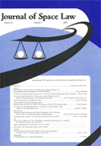
The sixth GEO Plenary meeting two weeks ago accepted a new set of implementation guidelines
Promoting implementation of the principle of full and open exchange of data in accordance with the GEOSS Data Sharing Principles
Enabling GEOSS users to reuse and re-disseminate shared data, metadata, and products.
Ensuring consistency in the implementation of the GEOSS Data Sharing Principles with relevant international instruments and national policies and legislation.
Implementing pricing policies consistent with the GEOSS Data Sharing Principles.
Reducing the time delays for making data available through GEOSS.
Promoting research and education uses of GEOSS data, metadata, and products.

Slide 16
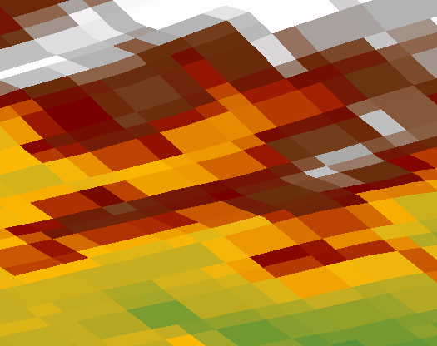
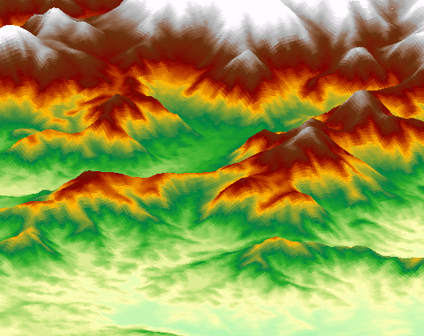
Whether GEO and GEOSS can really succeed in opening up access remains to be seen
Some countries such as Brazil and China are making important datasets openly available
But other data remain restricted, e.g., the US 30-m STRM dataset, for “national security” reasons
30 m
90 m
Comparison courtesy of V. Gorokhovich, CIESIN

Slide 17
The Polar Information Commons (PIC) is an international initiative to provide a long-term framework for polar data access and stewardship.
The PIC vision:
Data and information about the polar regions are public goods that should be shared ethically and with minimal constraint
The PIC is a shared virtual resource that parallels the “legal” commons in the Antarctic and the “shared interest” commons in the Arctic
The PIC provides both an institutional framework and a technical infrastructure for sharing and preservation of polar data in the short and long term
The PIC harnesses the collective expertise, capabilities, and resources of the broad community of polar stakeholders

Slide 18
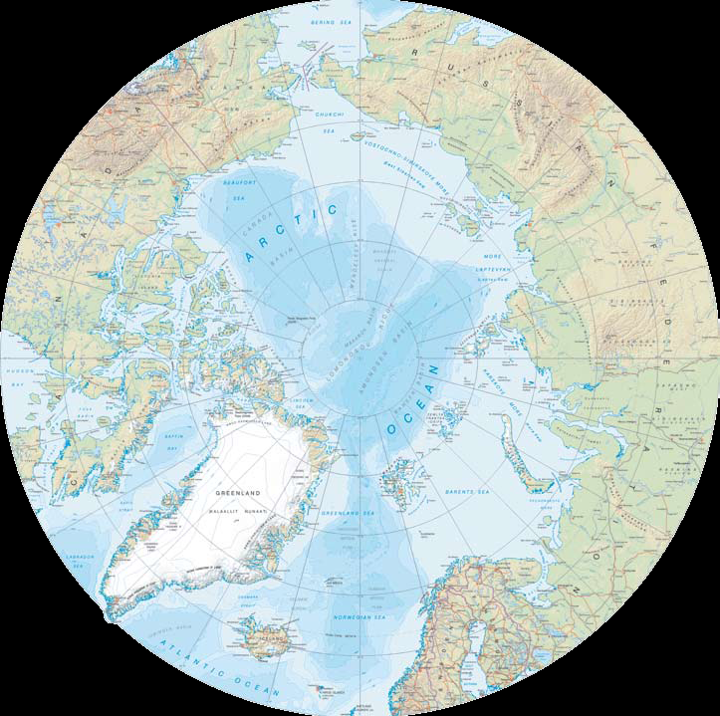
The situation in the Arctic is complex, but there is a clear need for information sharing based on the shared interests of the 8 Arctic nations as well as the rest of the world
Monitoring and prediction of Arctic climate changes and associated impacts on the global environment—including weather, climate, sea level , ecosystems
Opening of sea routes and coordination of rescue operations
Marine pollution
Fisheries and wildlife management
Energy extraction
Sustainable development for indigenous peoples

Slide 19
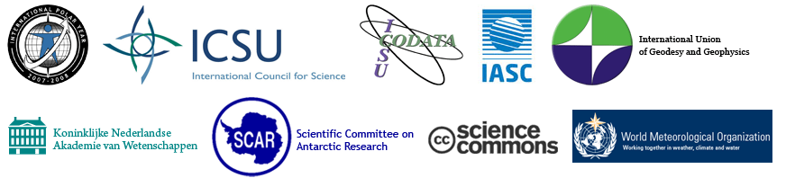
How is the PIC being implemented?
Core approach is based on the Science Commons Protocol for Implementing Open Access Data:
http://www.sciencecommons.org/projects/publishing/open-access-data-protocol/
Where possible, data owners/originators would use the Creative Commons Zero (CC0) license to place their data in the public domain or else use standard CC licenses where copyrights apply
The PIC is developing a digital label and a set of community norms to facilitate but not require data use and reuse consistent with community preferences

Slide 20
How would the PIC work?
Polar data sources expose their data to the world through the PIC label and open protocols
Data centers and archives monitor new PIC data and assess and acquire important data for formal archiving, curation, and access
The PIC community encourages compliance with PIC norms through peer pressure, brand identity, arrangements with journals and funding agencies, etc.
The PIC community provides useful tools for PIC data quality, search, access, documentation, attribution, metrics, etc.

Slide 21
Why is the Antarctic Treaty important to the PIC?
The Antarctic Treaty provides a legal and institutional framework for an information commons that encourages long-term participation and commitment of resources to data sharing by treaty signatories.
It also provides a demonstrable example of the value of data sharing:
across disciplinary and national boundaries
on decadal time scales
between governmental and nongovernmental entities
for both science and practical resource management

Slide 22
Why is the PIC potentially important to the Antarctic Treaty?
As we have seen in this summit, data and information about the polar regions gain value when understood in the context of the vast amount of polar data and information already collected.
The PIC provides a way for both treaty signatories and non- signatories to build a collective information resource vital to improved long-term understanding and management of the polar regions—and an extremely valuable resource for outreach to the world as a whole.

Slide 23
Concluding Thoughts
We now live in an “information society”—so enhancing the capacity of the Antarctic Treaty system to deal with data and information issues poses both critical challenges and unique opportunities
Open access to scientific data and information provides multiple benefits:
facilitation of interdisciplinary research and integration
more rapid progress and higher quality in science and applications
more efficient use of resources
wider community participation
long-term data and information stewardship
We welcome new participants in the PIC!

Slide 24
Thanks for your attention!
Earth Institute: http://www.earthinstitute.columbia.edu
CIESIN: http://www.ciesin.columbia.edu
SEDAC: http://sedac.ciesin.columbia.edu
CODATA: http://www.codata.org
GEO: http://www.earthobservations.org
PIC: http://www.polarcommons.org/

Slide 25
Proposed Norms for PIC Contributors
PIC contributors acknowledge that their submitted materials are already in the public domain, or that they have clear rights to make these materials openly accessible through the PIC.
PIC contributors agree to label their contributions digitally with the “PIC badge,” which specifies how rights have been waived and links back to this statement of norms, and agree to make these contributions accessible and searchable online.
PIC contributors agree to provide at least the minimum information about their contributed materials requested by the PIC submission interface as accurately and completely as possible.
PIC contributors agree that, if requested, they will make reasonable efforts to provide additional information about their contributed materials, e.g., to help document the quality of their submitted materials and to ensure their long-term usability.
PIC contributors agree that they will make reasonable efforts to provide appropriate notification to the PIC community (e.g., through PIC interfaces) of any significant errors in their contributed materials or descriptions, if any are discovered after submission.

Slide 26
Proposed Norms for PIC Users
PIC users agree that they will acknowledge the authorship or source of all materials that they use from the PIC, including use of an appropriate citation when data are used in a formal scientific publication.
PIC users agree that they will also give appropriate recognition to the role of the PIC as a digital community resource in their publications and value-added products and services.
PIC users agree that they will make reasonable and timely efforts through PIC interfaces to notify the relevant PIC contributors (or the PIC community more generally) about their use of specific digital materials from the PIC, and about any suspected significant errors, limitations, or other problems that they may have discovered in the course of their use of those materials.
PIC users acknowledge that they themselves are primarily responsible for determining whether the PIC materials they use are of sufficient quality and appropriateness for their objectives.
PIC users agree that they will endeavor to contribute back to the PIC any value-added data, information, or other digital content derived entirely or largely from PIC materials, with appropriate citation of and documentation about PIC and non-PIC inputs.

