Slide 1
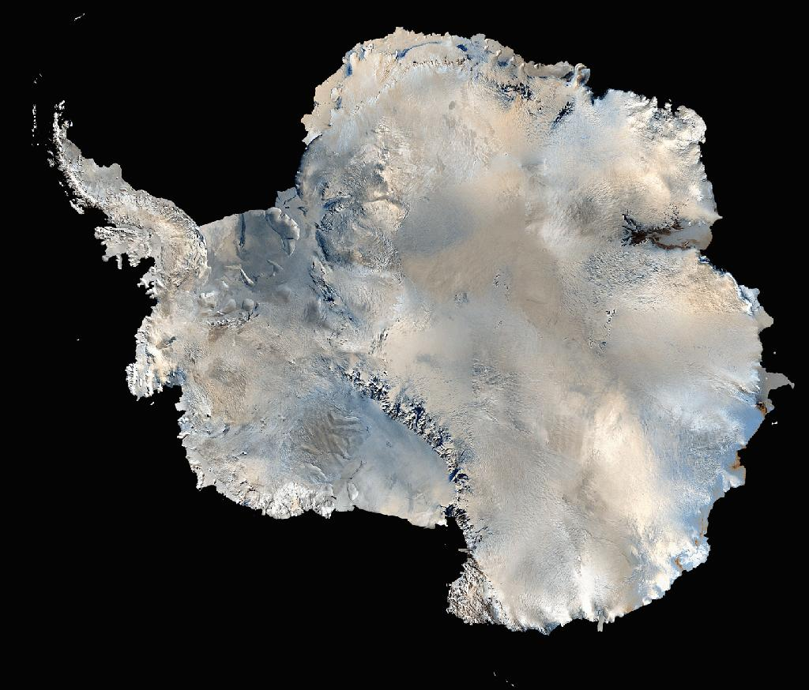
INTERNATIONAL ANTARCTIC SCIENCE:
THE SCIENTIFIC COMMITTEE ON ANTARCTIC RESEARCH
D.W.H.WALTON
BRITISH ANTARCTIC SURVEY

Slide 2
The Beginnings
The initiation of the International Geophysical Year by International Council of Scientific Unions (ICSU)
The importance of Space and Antarctica as new frontiers
The opportunity for countries to work together
The chance to use science for diplomacy in the Cold War

Slide 3
Special Committee on Antarctic Research
Proposed at 4th Comité Speciale de l’Année Geophysique Internationale(CSAGI) and agreed by ICSU in 1957
Representatives of the 12 Antarctic countries -
Argentina, Australia, Belgium, Chile, France, Japan,
Norway, New Zealand, Soviet Union,
South Africa, UK, USA
Representatives of 5 Scientific Unions and WMO
First meeting at The Hague in February 1958 (but without representatives of New Zealand and South Africa)

Slide 4
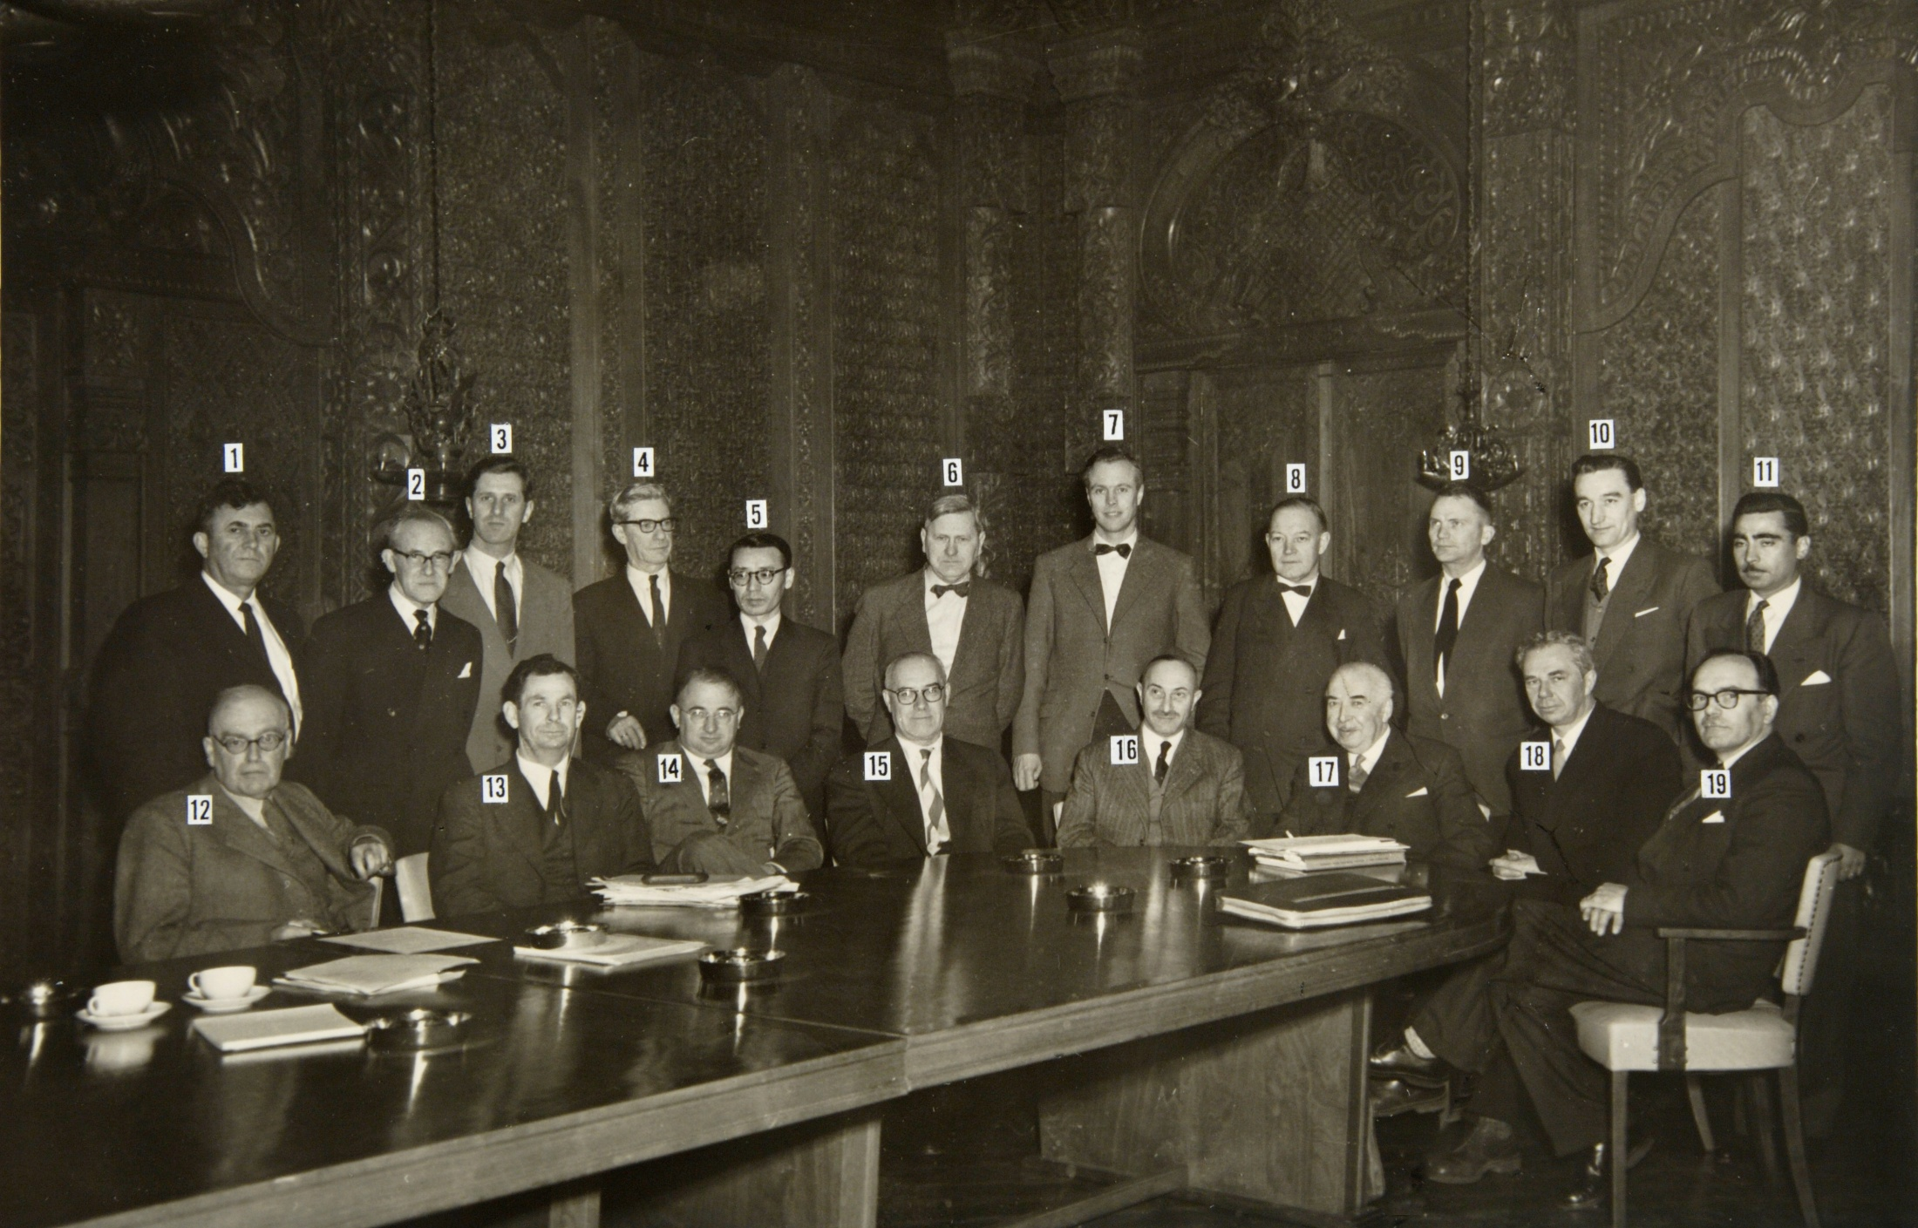
First Meeting of SCAR

Slide 5
CONSTRUCTING SCAR
Electing officers
Drafting an initial constitution
Setting a budget and a basis for levies
Devising a committee structure for governance (Delegates) and science (Working Groups)
Setting the geographical area of interest
Publishing decisions in SCAR Bulletin
Formation of National Committees

Slide 6
CONSTITUTION
Delegates actively engaged in research appointed by each country & by ICSU for Unions
President, Vice-President & Secretary to be elected from delegates
Exec expenses paid by SCAR but all others by National Committees
National Committees to frame & implement science programmes within SCAR framework

Slide 7
WORKING GROUPS
Initially 3 temporary groups:
Meteorology, cosmic physics, biology, physiology, oceanography
Geology, glaciology, morphology, cartography
Seismology, gravity, vulcanology
By 1960 these had changed to permanent Groups: Geology, Meteorology, Biology, Cartography,
Communications & Logistics

Slide 8
EARLY TREATY ACTIVITIES
By 1960 governments were urging SCAR to advise the Treaty
SCAR drafted material from which the Agreed Measures for the Conservation of the Antarctic Flora and Fauna were developed
Possibility of commercial sealing re-starting resulted in the Convention for the Conservation of Antarctic Seals with SCAR as science advisor
Concern over Soviet krill fishing precipitated development of the BIOMASS programme

Slide 9
EARLY SCIENCE ACTIVITIES
Initiation of major disciplinary symposia, first for meteorology, then geosciences and biology.
Establishment of agreed mapping symbols, joint mapping projects and exchange of maps
Continuation of IGY synoptic meteorology,
ionospheric sounding , geomagnetism, cosmic rays, gravity, geology
Initiation of new studies on oceanography,
marine biology, human physiology and glaciology

Slide 10
FORMATION OF COMNAP
SCAR Logistics Working Group was never as effective as it should have been
Appointment of Peter Wilkness at OPP initiated a change in concert with Jim Bleasel at AAD
Establishment of Council of Managers of National Antarctic Programs was on 15 September 1988

Slide 11
CATALYST FOR CHANGE
In 1998 at XXV SCAR in Concepcion revolt was in the air
Chris Rapley (UK) and Jörn Thiede (Germany) both challenged the structure and methods of SCAR as outdated
Ad Hoc Review Committee established (chaired by Phil Smith) reported in 2000 with 20 Recommendations

Slide 12
RECOMMENDATIONS FOR CHANGE
Be more assertive - including at the ATCM
Four delegate-level committees to run SCAR
Appoint an Executive Director
Delegates should have current scientific expertise
Seek more funding and promote young people
Improve communications internally and externally

Slide 13
PRIORITISING THE SCIENCE
Establishment of major new science programmes with time limits and international review
Establishment of Action Groups to develop specific initiatives
Establishment of bursaries to help young scientists

Slide 14
ACHIEVEMENTS - SCIENCE
Prince of Asturias Prize in 2002
Science basis for establishing CCAS and CCAMLR
Major input to all Treaty conservation legislation
Environmental monitoring
Antarctic forecasting manual
Antarctic climate & environment
Subglacial lakes
Open Science meetings

Slide 15
ACHIEVEMENTS - RESOURCES
Maps of the sub-ice topography (BEDMAP)
International seismic data library
Marine benthos database (MARBIN)
Antarctic Terrestrial Biodiversity Database
Digital maps of Antarctica (ADD)
Geodetic Control Database
Antarctic map catalogue
Antarctic composite gazetteer
Antarctic Master Directory & National Antarctic Data Centres

Slide 16
SCAR FORMAL

Slide 17
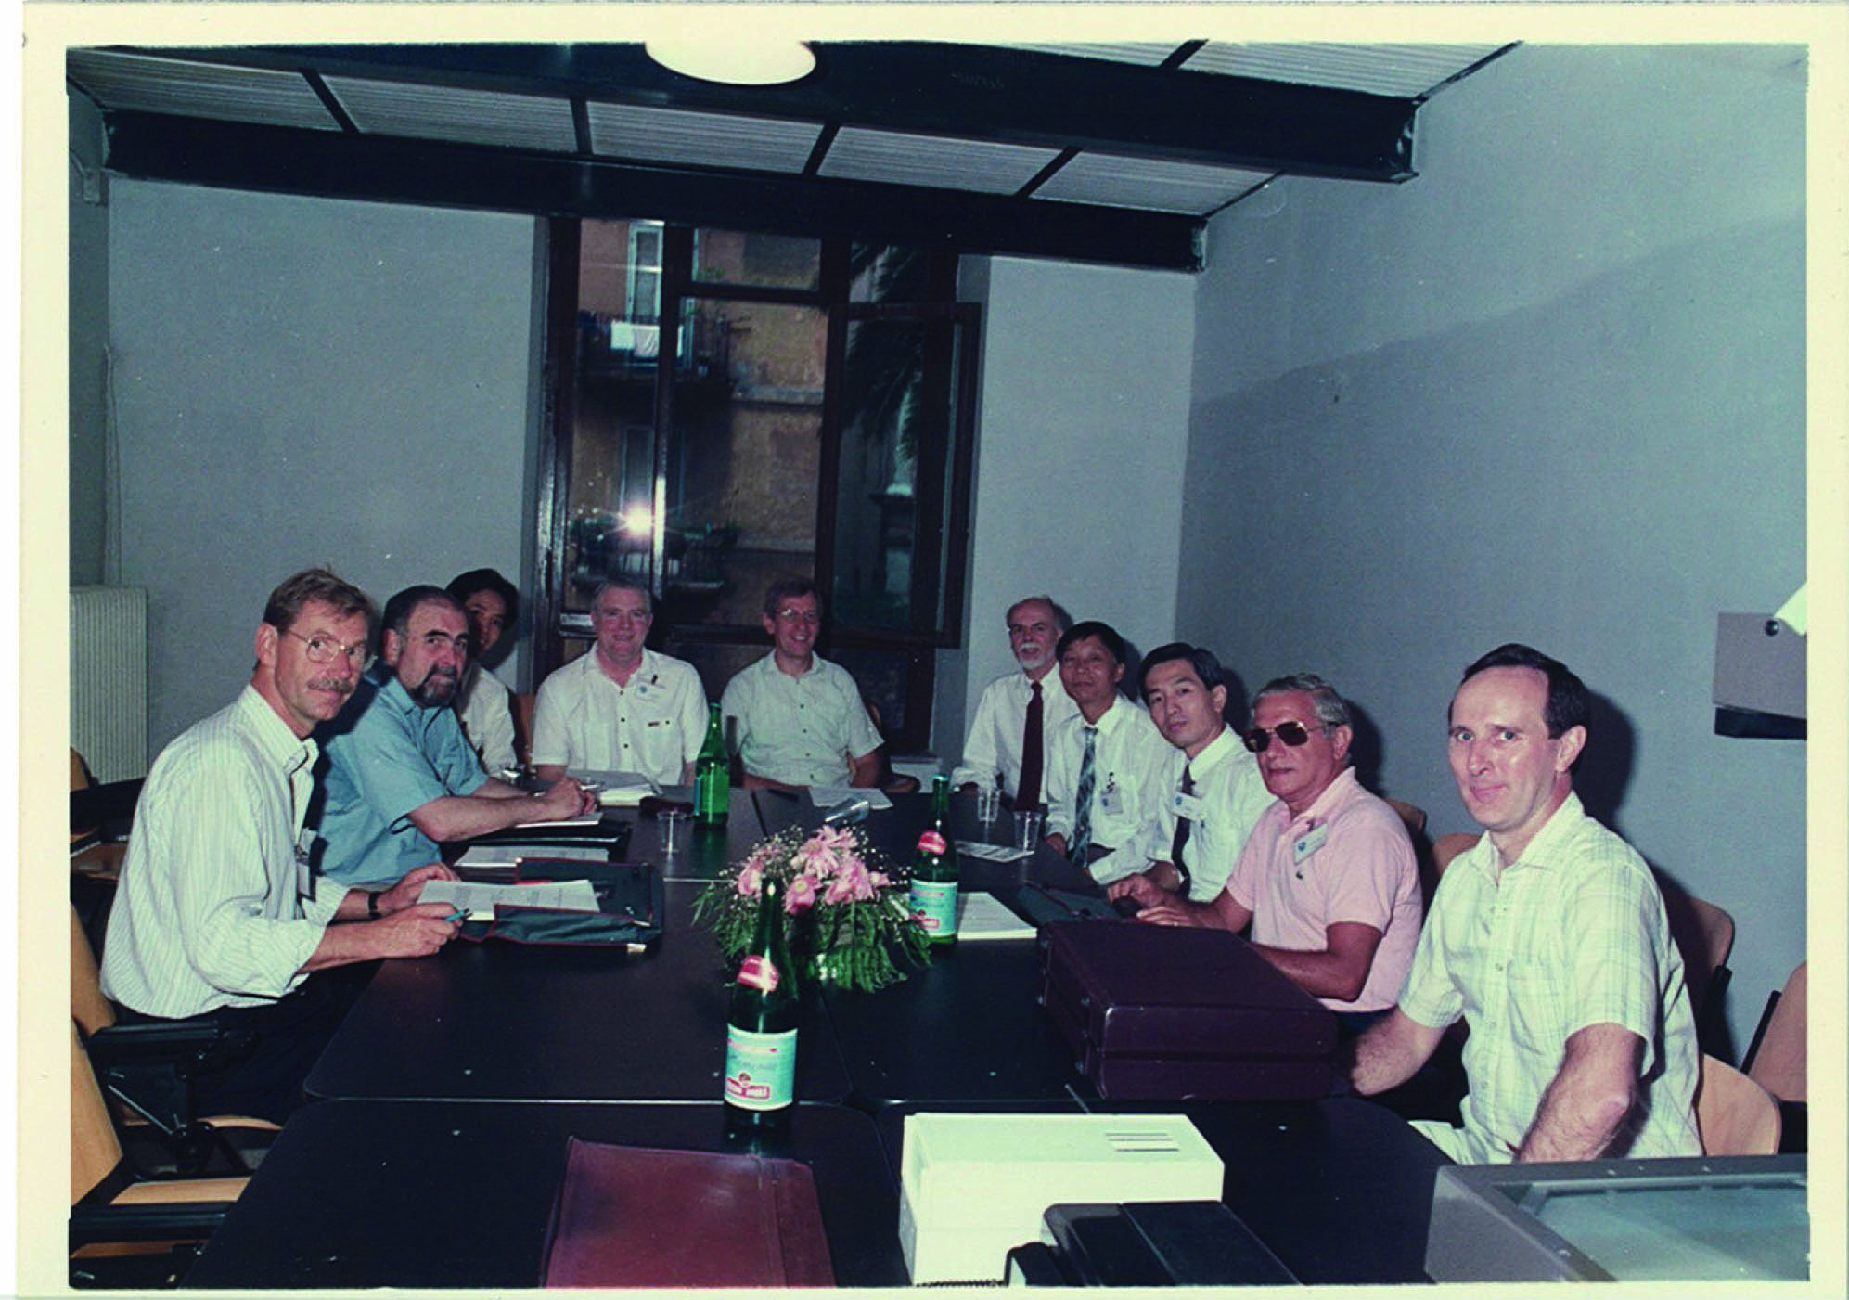
SCAR FORMAL

Slide 18
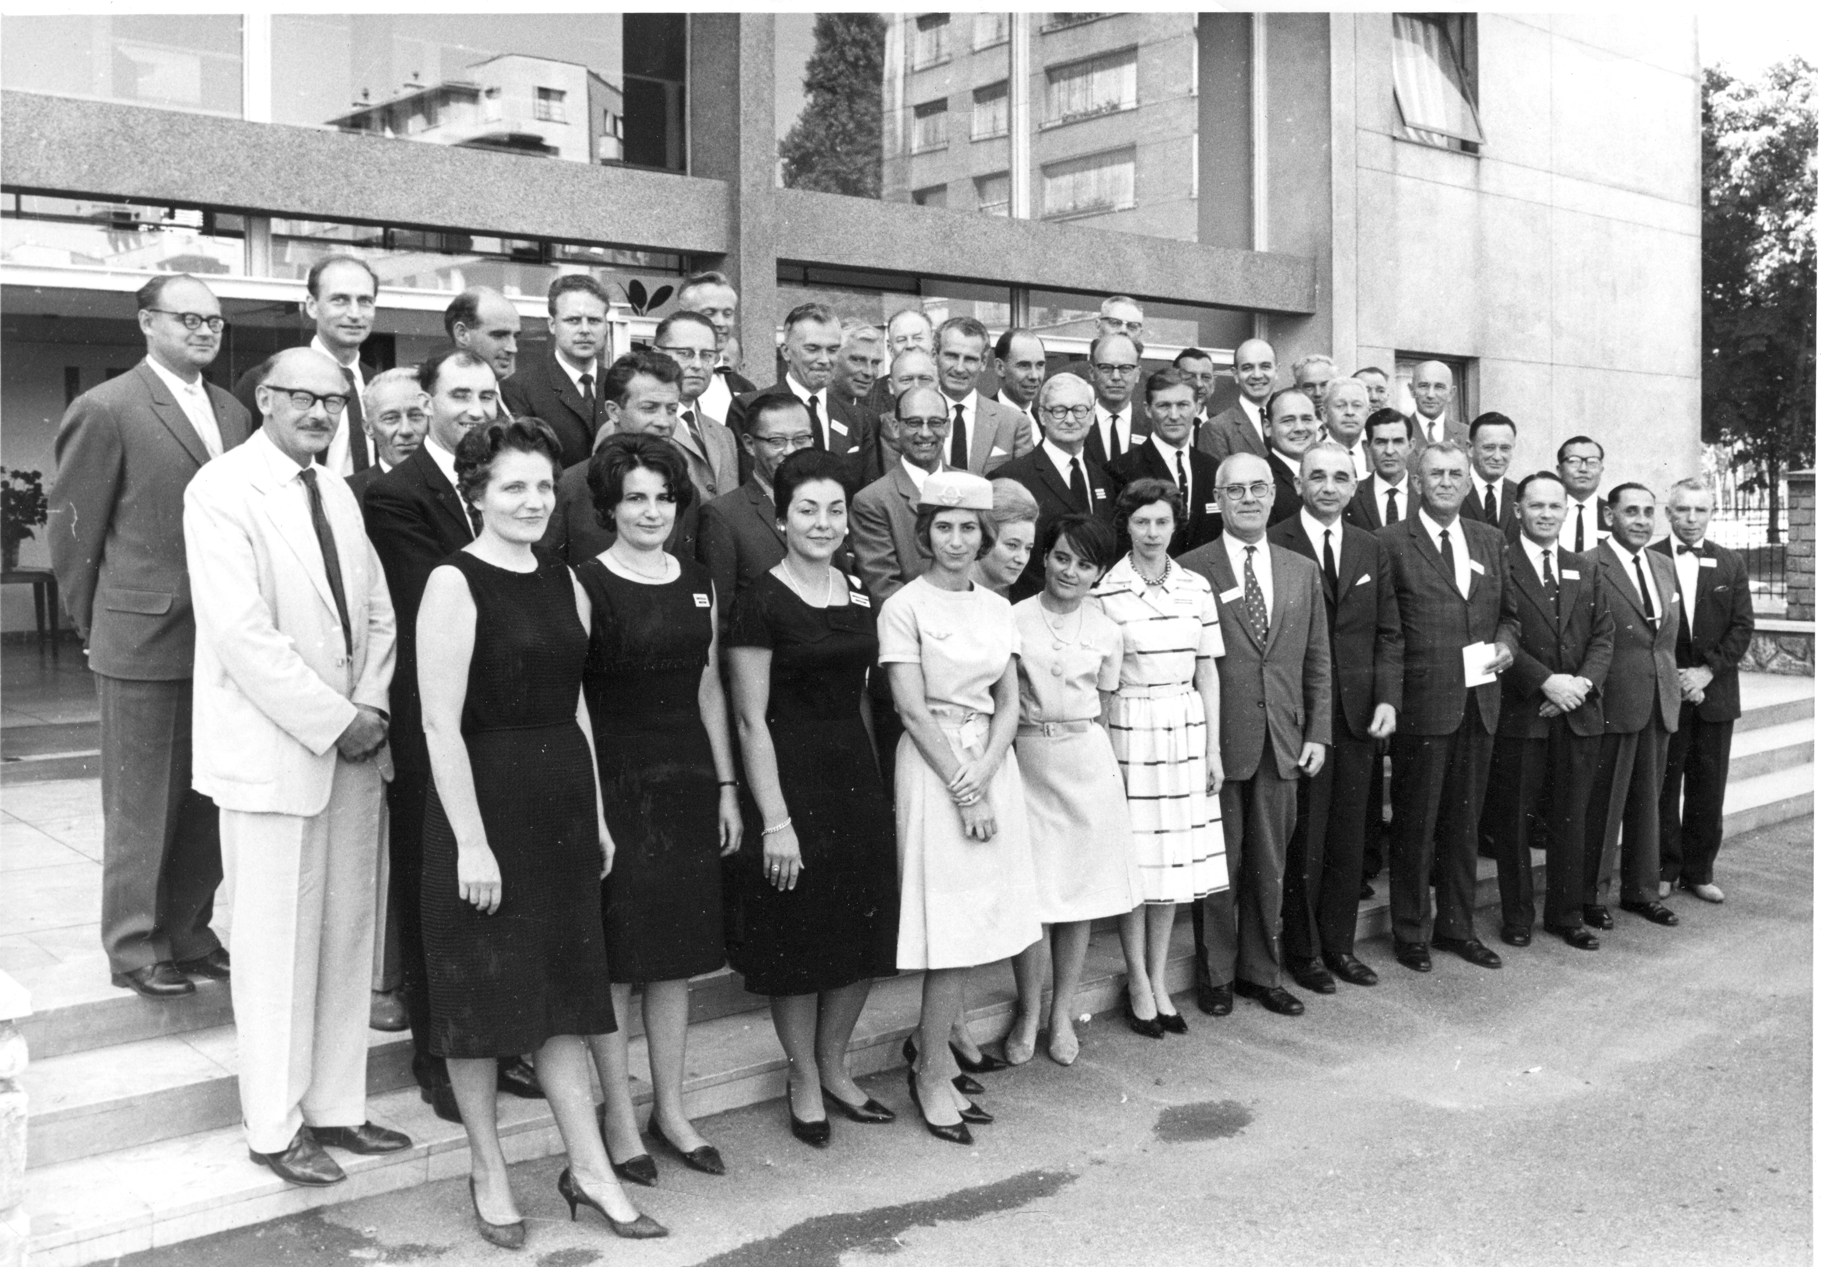
SCAR FORMAL

Slide 19
SCAR INFORMAL

Slide 20
THE SCAR MARCHING SONG
We are the men of SCAR, we are Antarctic is fraternity. We leave our homes for many months, 'Way from women's liberty.
Twelve nations all have delegates From South to Northern clime; The list is an impressive one, We're meeting all the time.
We've working groups and specialists, Symposia, and the lot; Our membership is limited A more exclusive bunch there's not.
Our meetings are away from home; There's a reason, don't you see? At home we're just a bunch of blokes, But here -- we're company.
]
The met boys are a happy lot. They look up in the sky. And though it’s ninety-nine below, They never wonder why.
Geophysicists do a job, They measure sound through ice, And when you see th’ results they get, It’s the same as shaking dice.
The Ross Ice Shelf has got to go, It’s been around too long, While we watch it disintegrate We’ll sing our happy song.
Geologists break rocks all day They work very hard, indeed. They climb the mountains and scale the peaks, All knowledge to impede.

Slide 22
SCAR EXECUTIVE IN SESSION

Slide 23
SCAR AT THE ATCM

Slide 24
MEMBERSHIP OF SCAR & TREATY

Slide 25
PROBLEMS & SOLUTIONS
In many countries National Committees have proved inadequate
Improved communications via web site and program groups

Slide 26
PROBLEMS & SOLUTIONS
In many countries National Committees have proved inadequate
Improved communications via web site and program groups
Inadequate funding and staffing
Executive Director, interns & better funding

Slide 27
PROBLEMS & SOLUTIONS
In many countries National Committees have proved inadequate
Improved communications via web site and program groups
Inadequate funding and staffing
Executive Director, interns & better funding
Inadequate systems for governance and management
Inclusion of key Chairs in Exec meetings and cross discipline meetings of Programme leaders

Slide 28
PROBLEMS & SOLUTIONS
In many countries National Committees have proved inadequate
Improved communications via web site and program groups
Inadequate funding and staffing
Executive Director, interns & better funding
Inadequate systems for governance and management
Inclusion of key Chairs in Exec meetings and cross discipline meetings of Programme leaders
Inadequate Antarctic expertise of some delegates
More experienced and engaged delegates

Slide 29
PROBLEMS & SOLUTIONS
In many countries National Committees proved inadequate
Improved communications via web site and program groups
Inadequate funding and staffing
Executive Director, interns & better funding
Inadequate systems for governance and management
Inclusion of key Chairs in Exec meetings and cross discipline meetings of Programme leaders
Inadequate Antarctic expertise of some delegates
More experienced and engaged delegates
Lack of connection with young scientists
Establishment of bursaries, links with APECS, internships

Slide 30
PROBLEMS & SOLUTIONS
Lack of representation at ATCM
Appointment as Observer & initiation of annual science lecture

Slide 31
PROBLEMS & SOLUTIONS
Lack of representation at ATCM
Appointment as Observer & initiation of annual science lecture
Change in Treaty role with formation of CEP
Development of more active role in providing information and advice

Slide 32
PROBLEMS & SOLUTIONS
Lack of representation at ATCM
Appointment as Observer & initiation of annual science lecture
Change in Treaty role with formation of CEP
Development of more active role in providing information and advice
Lack of focus on key science areas
Establishment of 5 major peer reviewed programs

Slide 33
PROBLEMS & SOLUTIONS
Lack of representation at ATCM
Appointment as Observer & initiation of annual science lecture
Change in Treaty role with formation of CEP
Development of more active role in providing information and advice
Lack of focus on key science areas
Establishment of 5 major peer reviewed programs
• Establishment of a legal persona
Registration as UK charity & not-for-profit company

Slide 34
THE FUTURE
More candidate countries likely to join SCAR
Closer links with IASC for developing a bipolar perspective
Closer links with other appropriate international bodies (like SCOR & IPCC) to increase leverage and available expertise
Active international promotion of the role of SCAR

