Slide 1
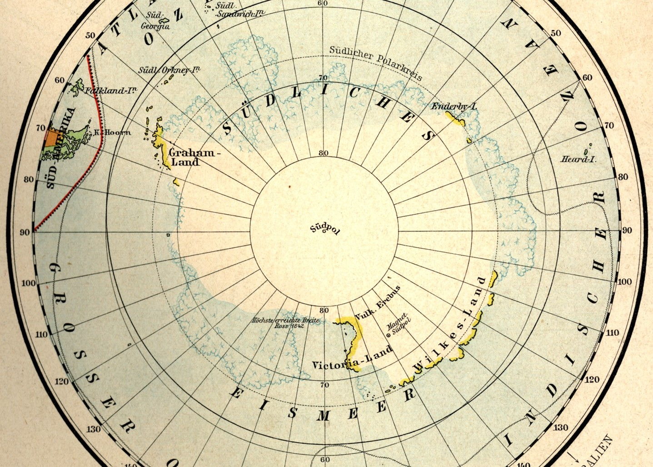
Parallel Agendas for the
International Geophysical Year
Cornelia Lüdecke, München SCAR History Action Group
Outline
Spitsbergen / Svalbard Antarctica
1900 - IGY
1
1

Slide 2
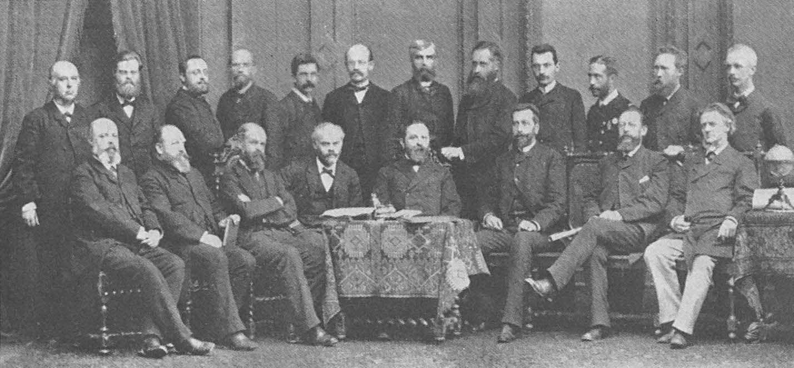
Archipelago of Spitsbergen - Svalbard
1880 1890 1900 1910 1920
WW I
1882-1883
International Meteorological Committee
=> Commission for the Polar Year (1879-1891) Aim: Meteorology and Magnetism
(weather forecast and navigation)
Georg Neumayer
4th International Polar Conference in Vienna (1884)
1882-1883
1880 1890 1900 1910 1920
Antarctica
2

Slide 3
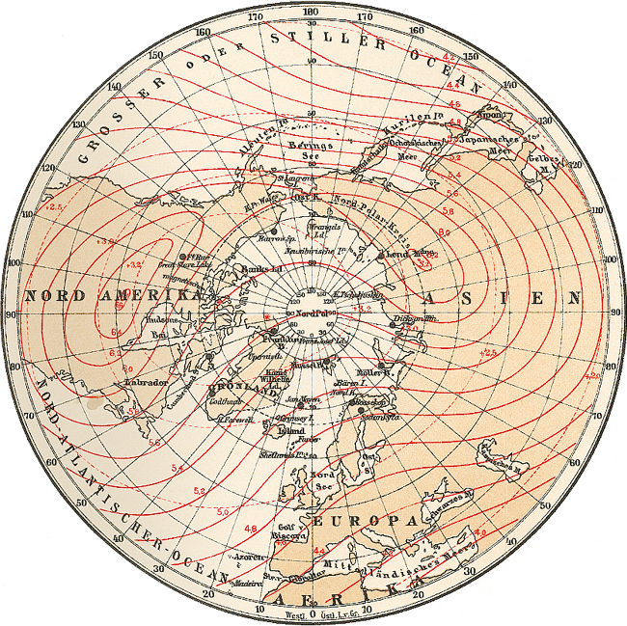
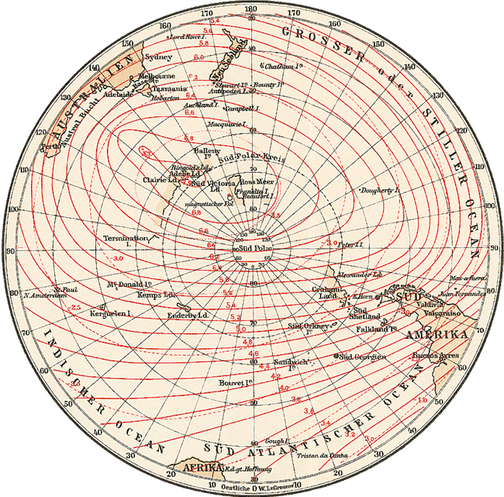
Archipelago of Spitsbergen - Svalbard
1880 1890 1900 1910 1920
WW I
1882-1883
1st International Polar Year (1882-1883)
12 Arctic stations
South Pole
2 Southern stations
No central bureau for collecting data
1882-1883
1880 1890 1900 1910 1920
Antarctica
3

Slide 4
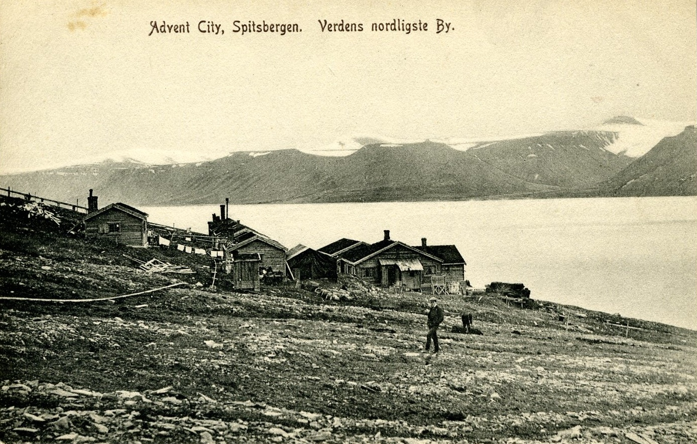
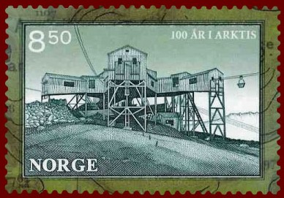
Archipelago of Spitsbergen - Svalbard
1880 1890 1900 1910 1920
WW I
Coal mining since 1894
Advent City (GB) Longyearbyen (USA) Hiorthamn (N) Barentsburg (N) Sveagruva (S)
Ny Ålesund (N)
Grumantbyen (SU) Pyramiden (SU)
1880 1890 1900 1910 1920
Antarctica
4

Slide 5
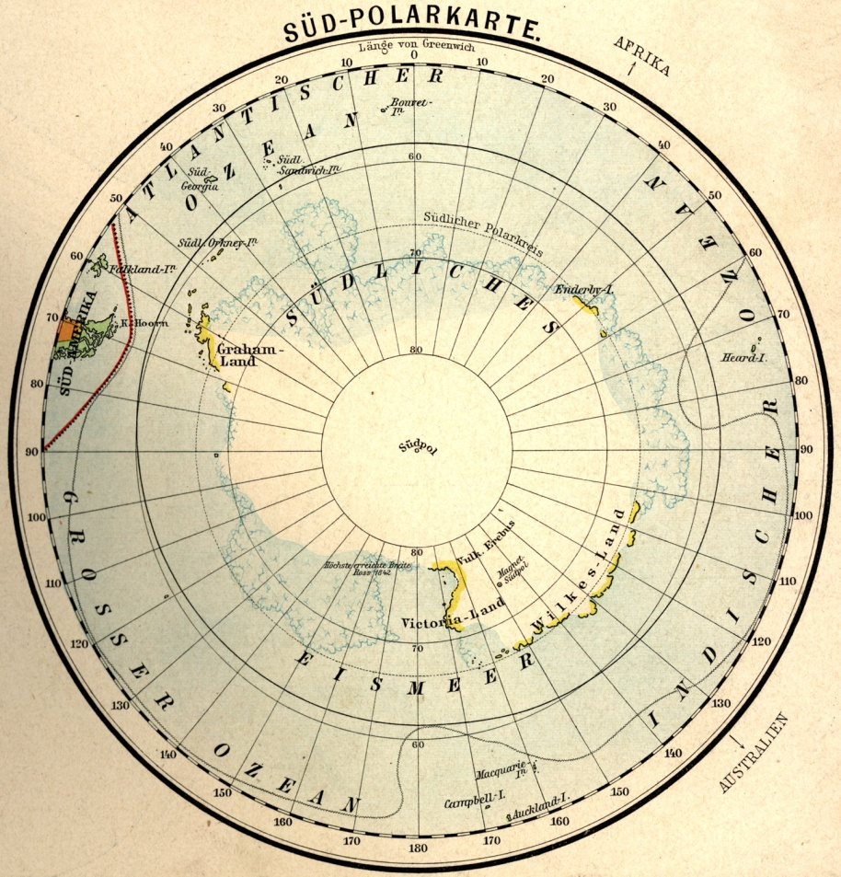
Archipelago of Spitsbergen - Svalbard
1880 1890 1900 1910 1920
WW I
6th International Geographical Congress
in London (1895)
“... the exploration of the Antarctic Regions is the greatest piece of geographical exploration still to be undertaken.
... the Congress recommends that the scientific societies throughout the world should urge, in whatever way seems to them most effective, that this work should be undertaken before the close of the century.”.
Southern
South Pole
Ice Ocean
German south-polar map (1895)
1880 1890 1900 1910 1920
Antarctica
5

Slide 6
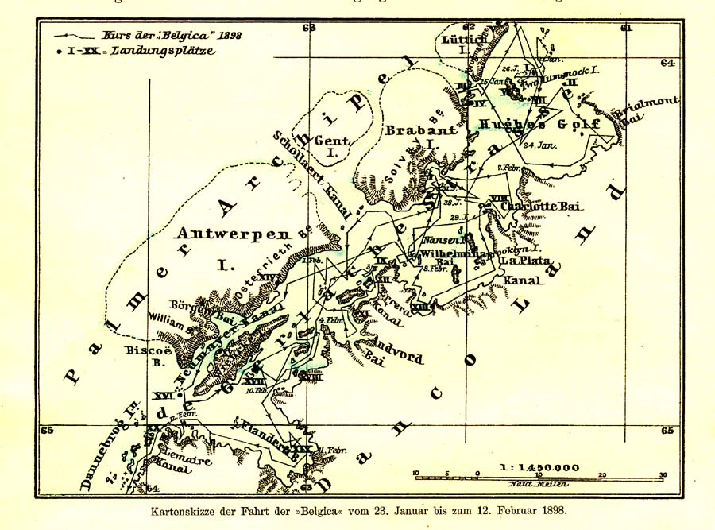
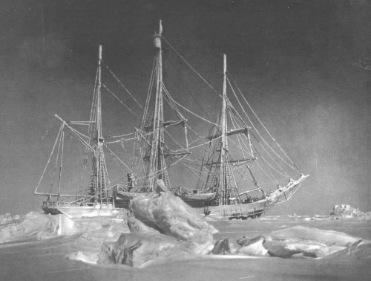
Archipelago of Spitsbergen - Svalbard
1880 1890 1900 1910 1920
WW I
“Belgica” expedition
(1897-1899)
International crew
1st overwintering
1880 1890 1900 1910 1920
Antarctica
6

Slide 7
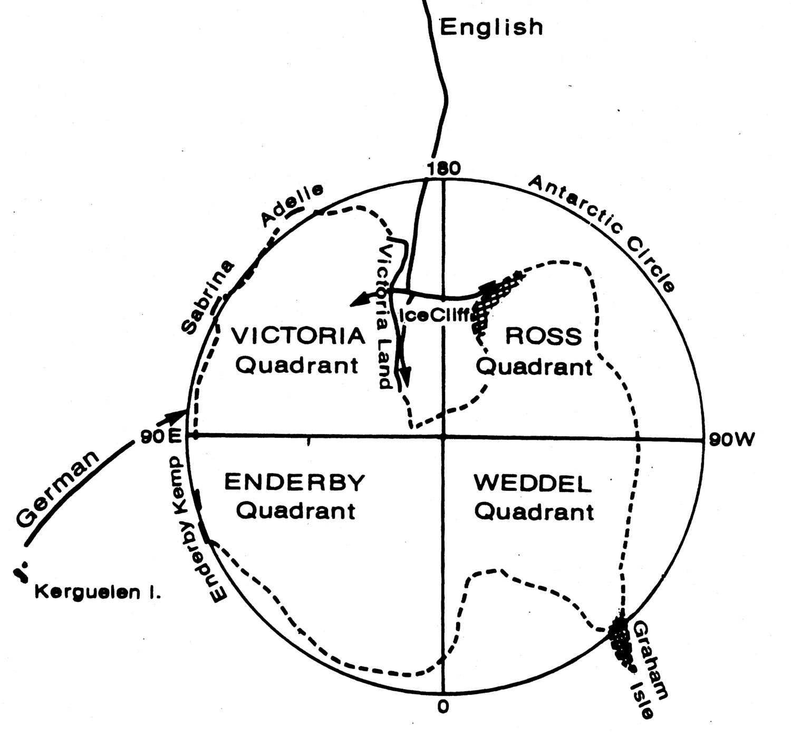
Archipelago of Spitsbergen - Svalbard
1880 1890 1900 1910 1920
WW I
7th International Geographical
Congress in Berlin (1899)
British
Agreement
International Meteorological and Magnetic Cooperation
German
Division of working areas (1899)
1880 1890 1900 1910 1920
Antarctica
7

Slide 8
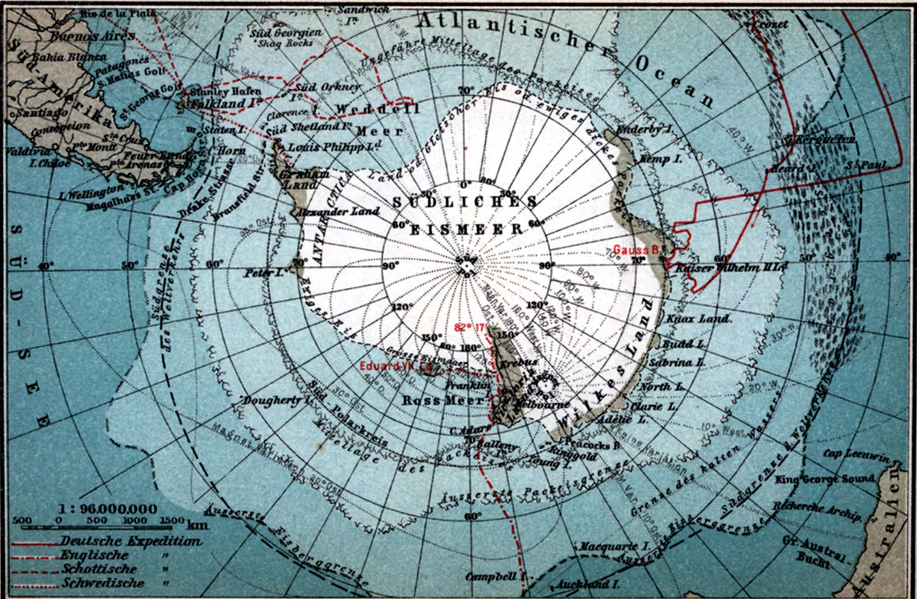
Four expeditions of the International Co-operation (1901-1904)
Bruce
Nordenskjöld
Drygalski
Southerly Ice Ocean
Scott
8

Slide 9
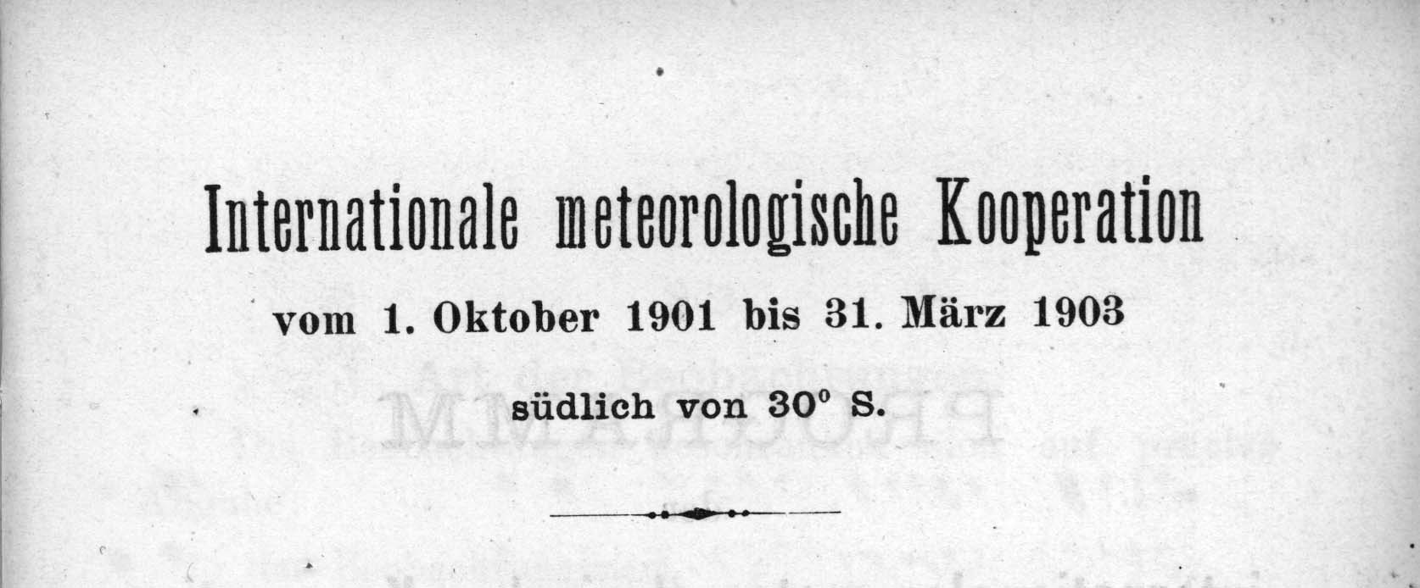
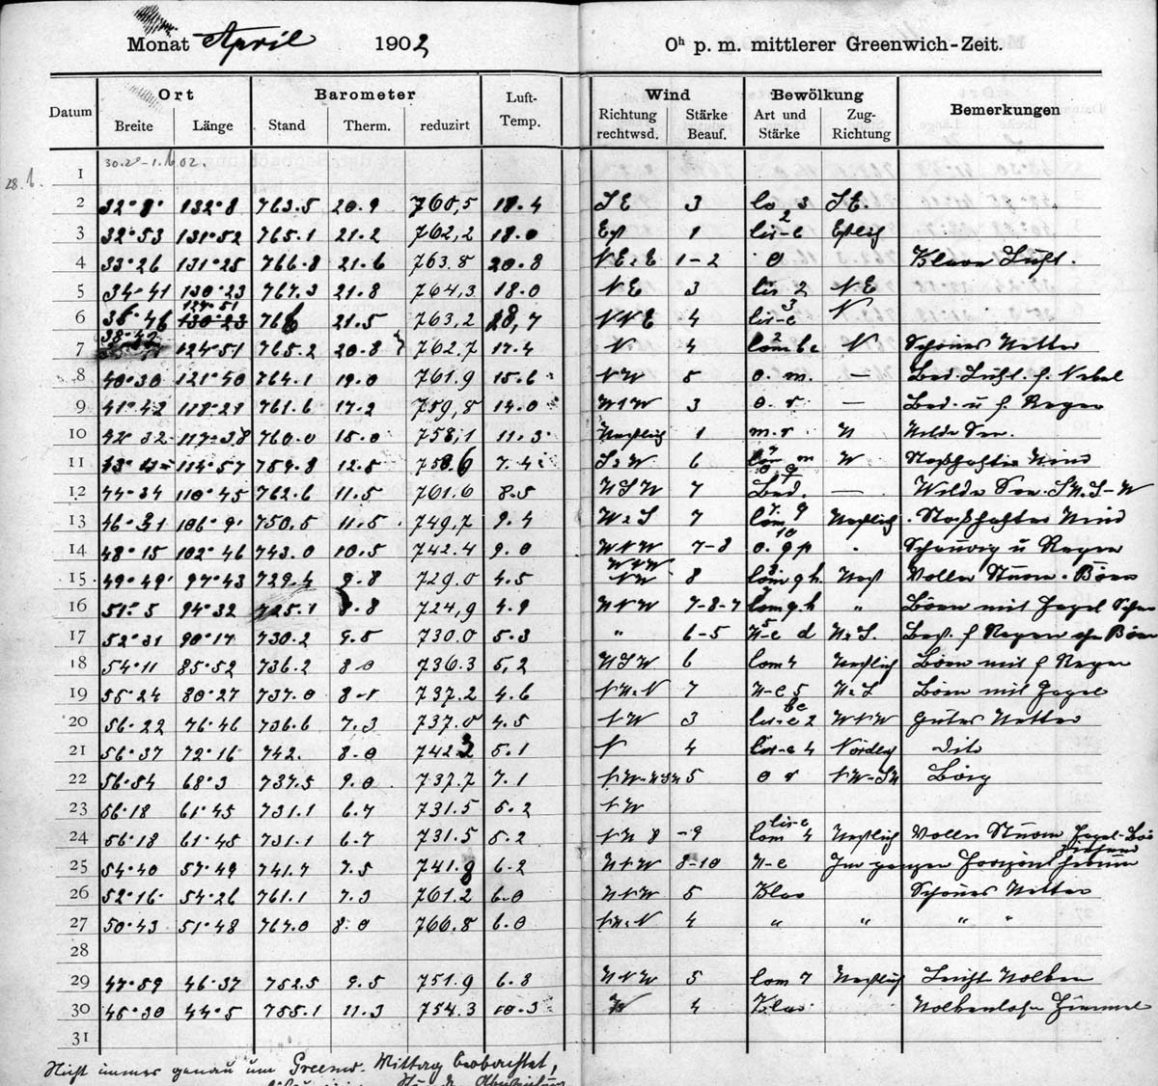
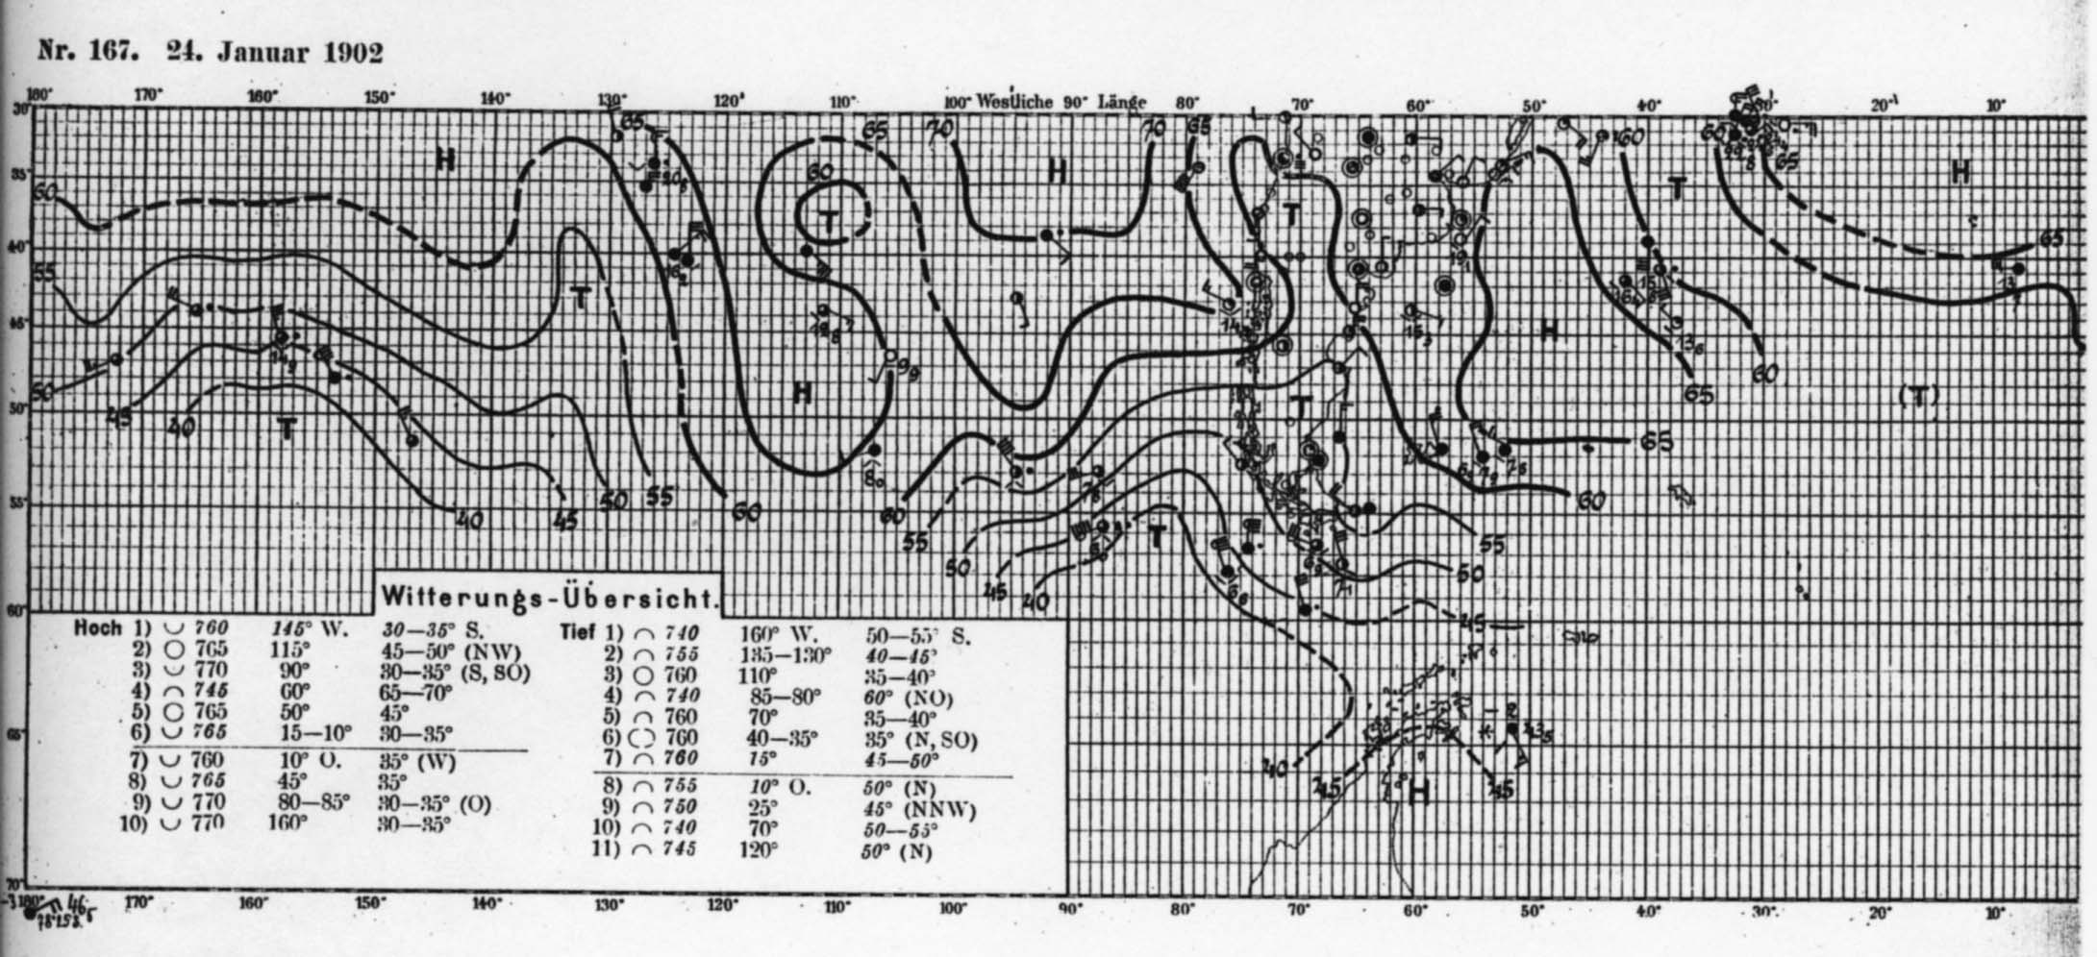
Archipelago of Spitsbergen - Svalbard
1880 1890 1900 1910 1920
WW I
1880 1890 1900 1910 1920
Antarctica
9

Slide 10
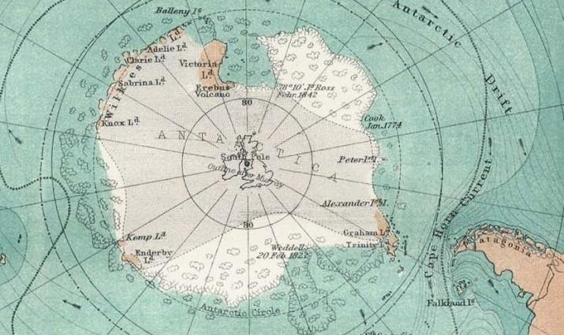
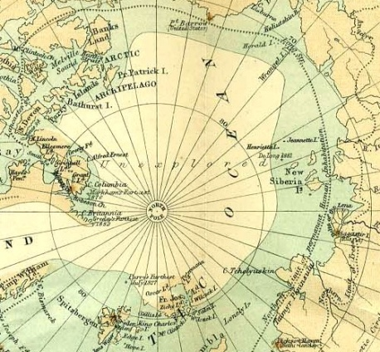
Archipelago of Spitsbergen - Svalbard
1880 1890 1900 1910 1920
WW I
International Congress on World Economy
at Mons (Belgium) in 1905
Presentation of results of Antarctic expeditions
Lecointe’s initiative:
”International Association of Polar Research”
Aim: to solve
open questions
of geography
(the Poles)
1894
1885
?
?
1880 1890 1900 1910 1920
Antarctica
10

Slide 11
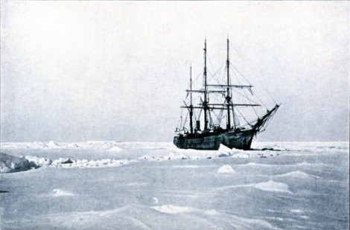
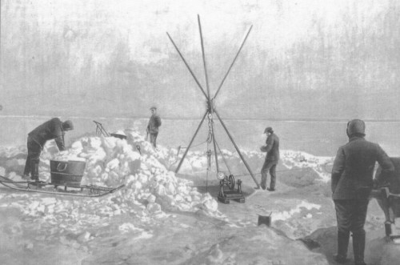
Archipelago of Spitsbergen - Svalbard
1880 1890 1900 1910 1920
WW I
Arctowski’s focus on Antarctica (1905)
1. Geographical research expeditions
2. Permanent circumpolar over-wintering stations (systematic scientific investigation )
3. Supplementary extended overland journeys (geological investigations of the continent)
“Belgica”
1899
1880 1890 1900 1910 1920
Antarctica
11

Slide 12
Archipelago of Spitsbergen - Svalbard
1880 1890 1900 1910 1920
WW I
International Congress for the Study of Polar Regions (Brussels, 1906)
Brussels (1908)
President: Cagni (Italy)
Vice president: Nordenskjöld (Sweden)
Secretary General: Lecointe (Belgium)
Race to the Poles
Rome (1913)
Inauguration of “International Polar Commission”
President: Tschernyschew (Russia)
Vice president: Nordenskjöld (Sweden)
Secretary General: Peary (USA)
1880 1890 1900 1910 1920
Antarctica
12

Slide 13
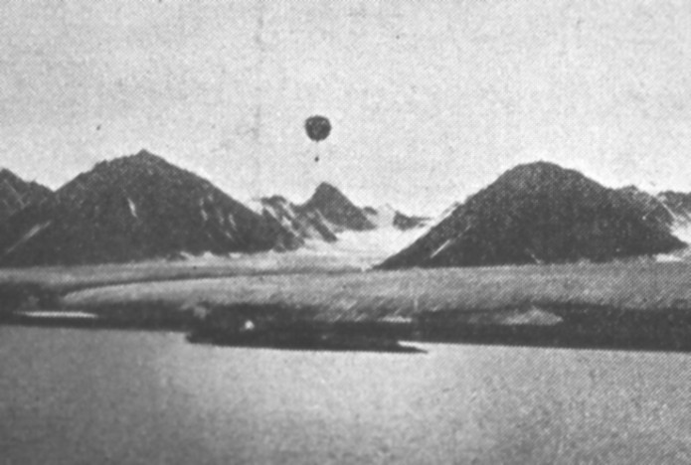
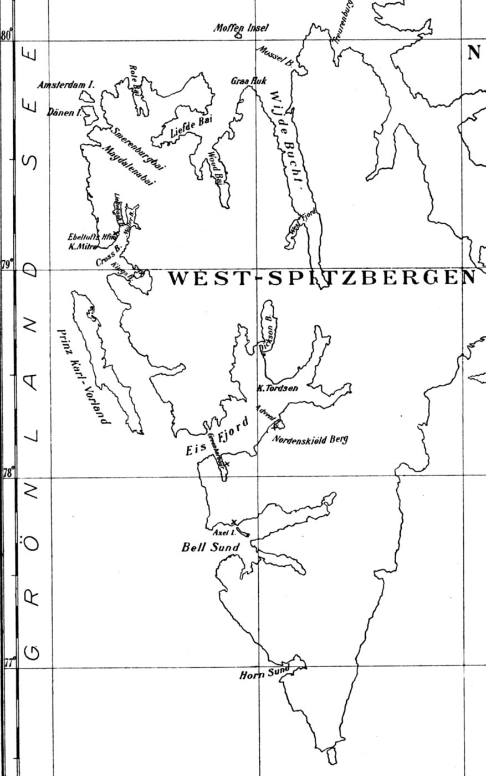
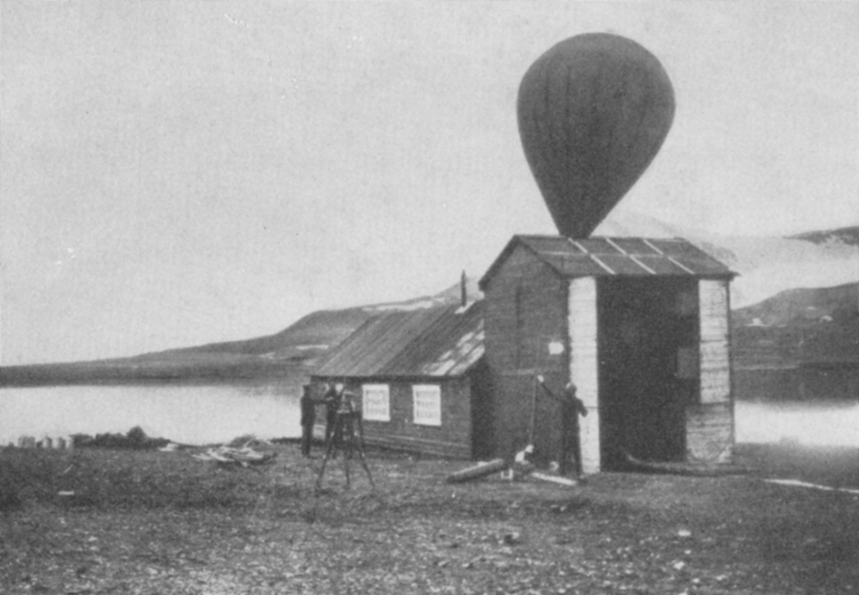
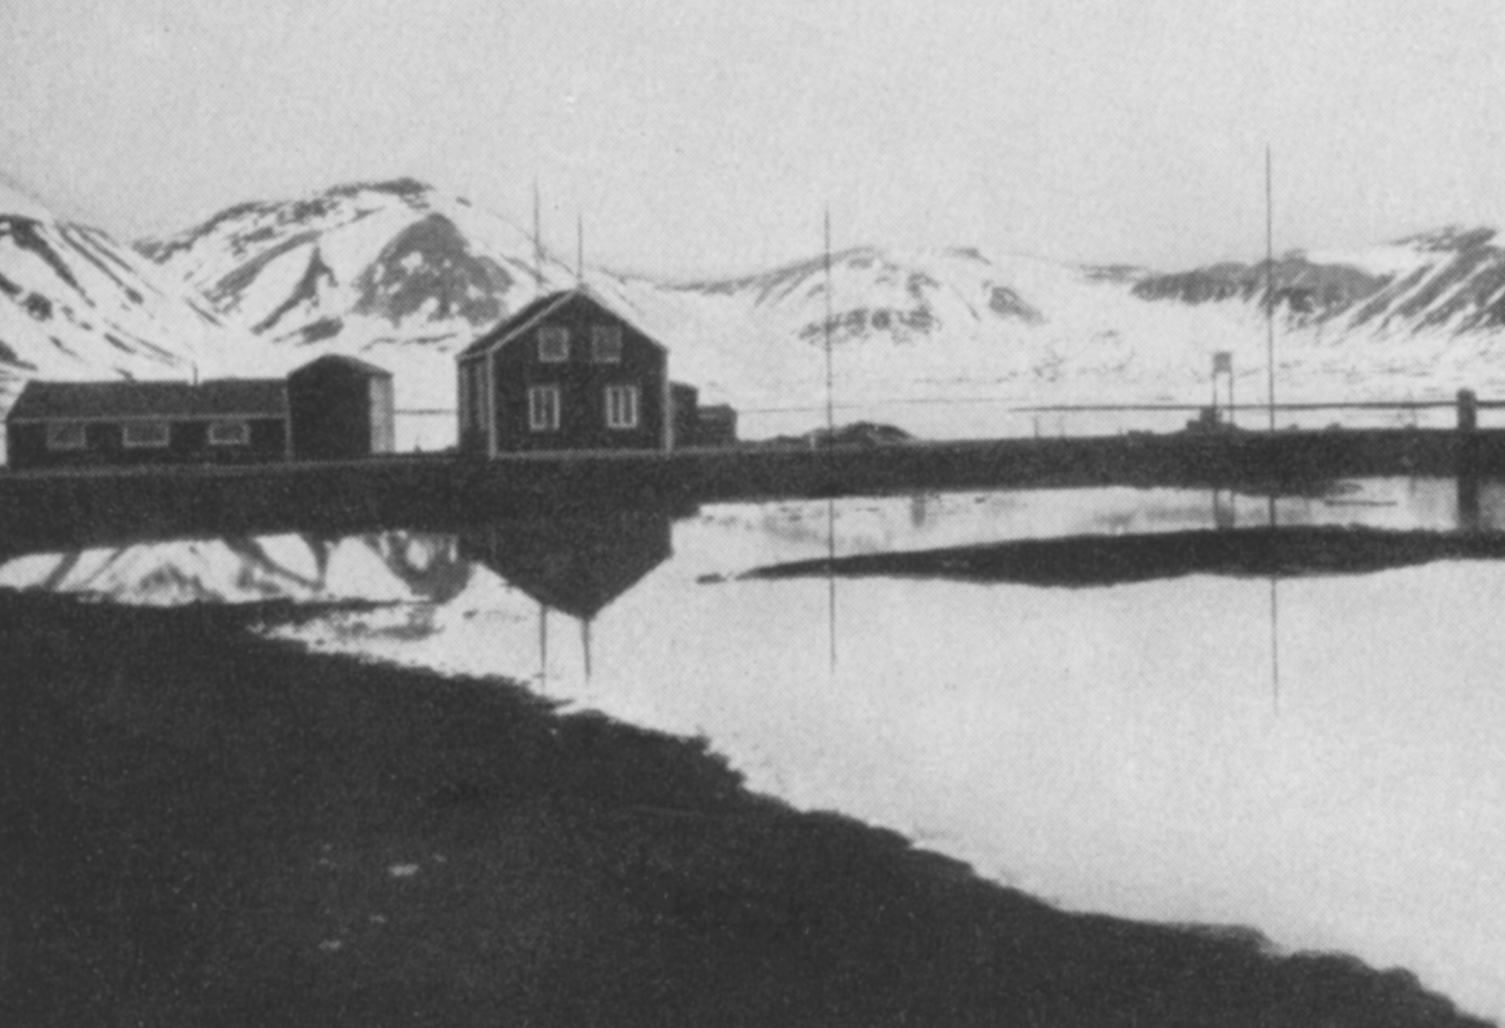
Archipelago of Spitsbergen - Svalbard
1880 1890 1900 1910 1920
WW I
Zeppelin Study Expedition 1910
German Geophysical Observatory (1911-1914)
Ebeltofthamna
1880 1890 1900 1910 1920
Antarctica
13

Slide 14
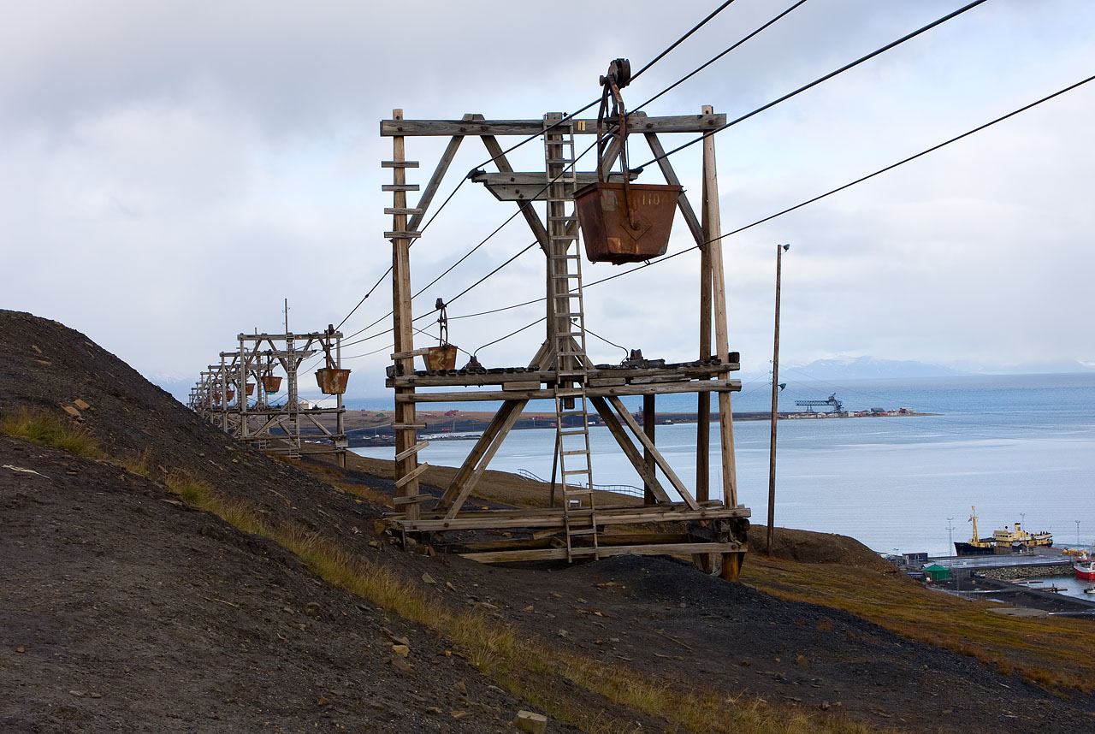
Archipelago of Spitsbergen - Svalbard
1880 1890 1900 1910 1920
WW I
Svalbard (since 1900)
Expansion of mining claims
Norwegian interest in resources
=> Norwegian, Swedish and Russian administration?
1880 1890 1900 1910 1920
Antarctica
14

Slide 15
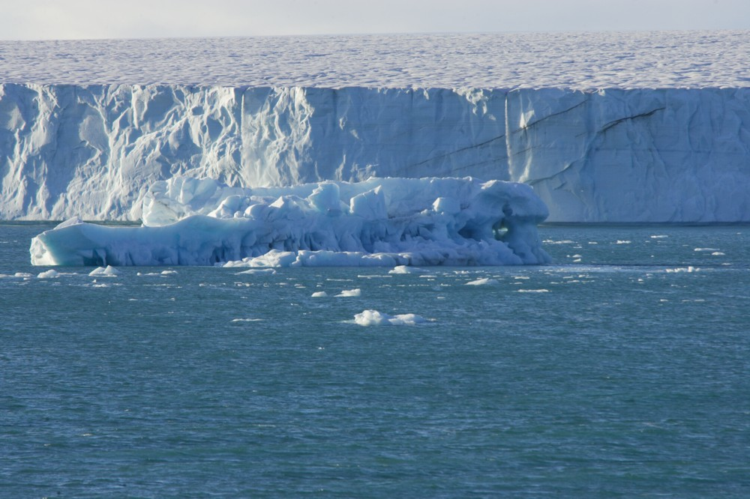
Archipelago of Spitsbergen - Svalbard
1920 1930 1940 1950 1960
Svalbard Treaty (1920)
(Denmark, France, Great Britain, Ireland, Italy,
Japan, the Netherlands, Norway, USA, Sweden)
Norway's full sovereignty over Svalbard
Demilitarization
Free communications
Equal rights of economic exploitation
Peaceful utilization of the archipelago.
Management and regulation of research in Svalbard
Establishment of an international meteorological station
=> Grants for exploration => Norwegian Polar Institute (1928)
1920 1930 1940 1950 1960
Antarctica
15

Slide 16
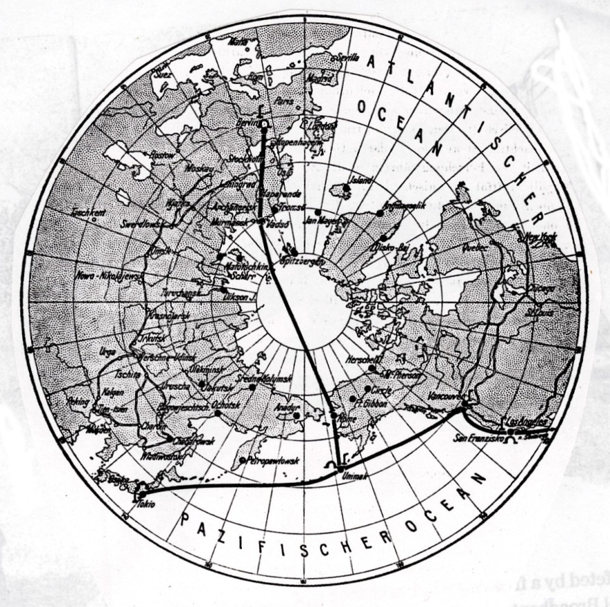
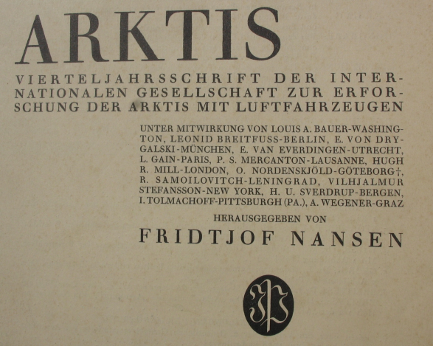
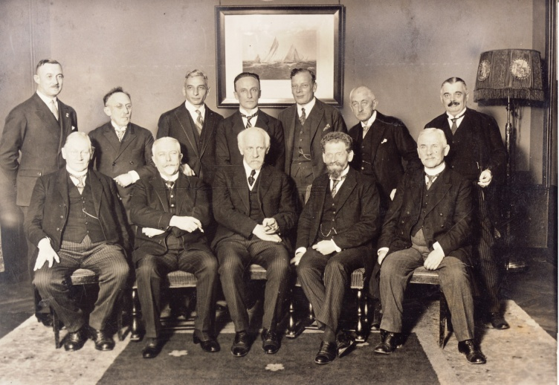
Archipelago of Spitsbergen - Svalbard
1920 1930 1940 1950 1960
Trans-Arctic airline with airships (Bruns 1919)
International Society for the Exploration of the Arctic Regions by Means of Aircraft
(1924)
(1928-1931)
Nansen
1920 1930 1940 1950 1960
Antarctica
16

Slide 17
Archipelago of Spitsbergen - Svalbard
1920 1930 1940 1950 1960
Aeroarctic
Council of the Society
(29 members)
General Assembly
(396, 42 bodies)
Exploration Council
(42 members)
President
Treasurer
Secretary
and Deputies
6 Vice presidents
(12 members)
Board of Exploration Council
(5 members)
Representatives of National Councils
(12 members)
Technical Commissions
(4)
Scientific Commissions
(7)
32 % German members
20 % Russian members
12 % American members
Status 1931
1920 1930 1940 1950 1960
Antarctica
17

Slide 18
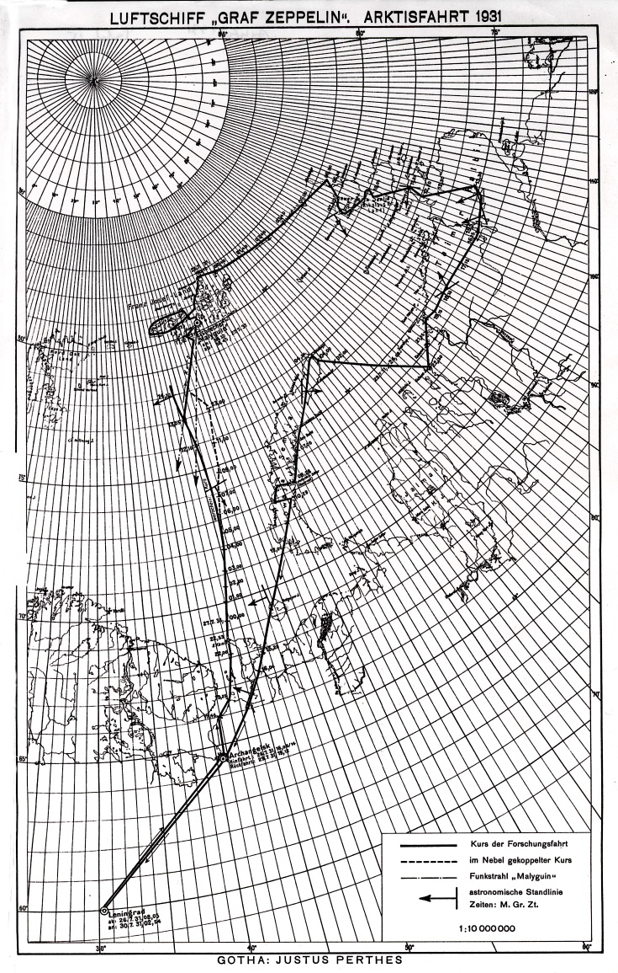
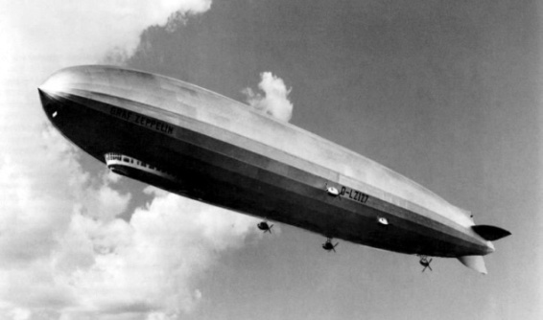
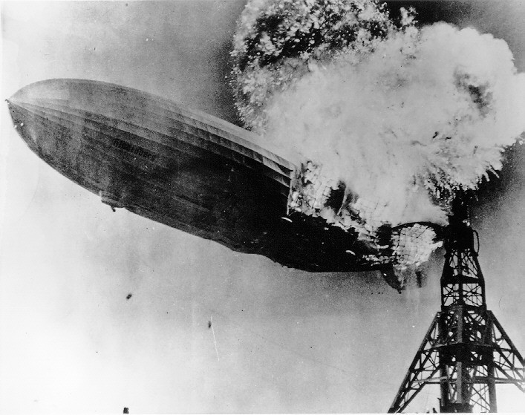
Archipelago of Spitsbergen - Svalbard
1920 1930 1940 1950 1960
Aeroarctic Expedition
26-30 July 1931
LZ 129 „Hindenburg“
Lakehust, 6 May 1937
=> Dissolvement of Aeroarctic
1920 1930 1940 1950 1960
Antarctica
18

Slide 19
Archipelago of Spitsbergen - Svalbard
1920 1930 1940 1950 1960
2nd International Polar Year (1932-1933)
organized by IMO and IUGG (ICSU)
Commission Internationale de l‘Année Polaire
(12 members)
(1931) 7 overlapping memberships
(4 members in Council of Aeroarctic !)
Aeroarctic (396 members)
Everdingen International Polar => President of IMO Council of
Arctowski Commission 1906 -13 Aeroarctic
1920 1930 1940 1950 1960
Antarctica
19

Slide 20
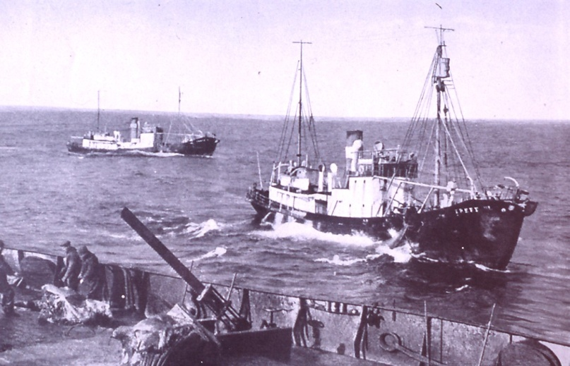
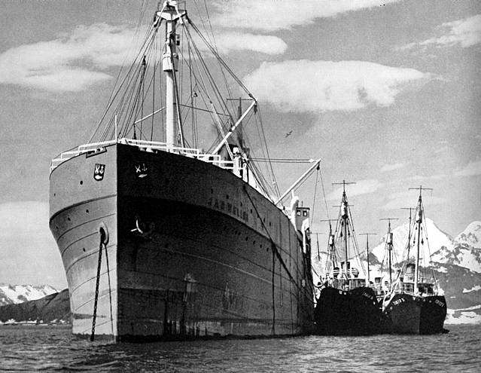
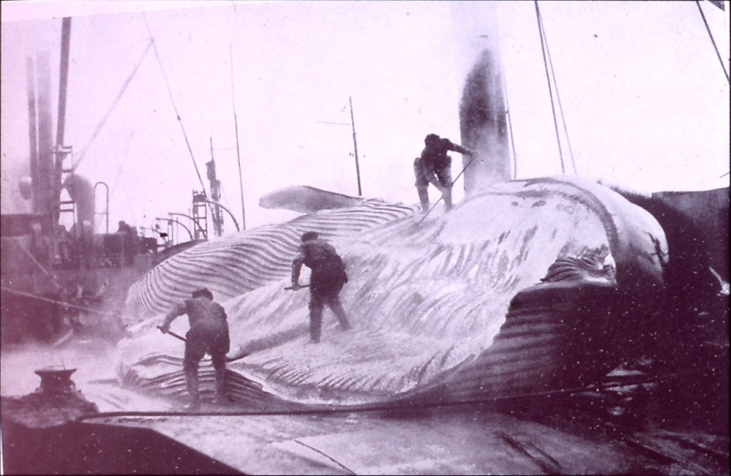
Archipelago of Spitsbergen - Svalbard
1920 1930 1940 1950 1960
Whaling in Antarctica
=> Economic interests
1920 1930 1940 1950 1960
Antarctica
20

Slide 21
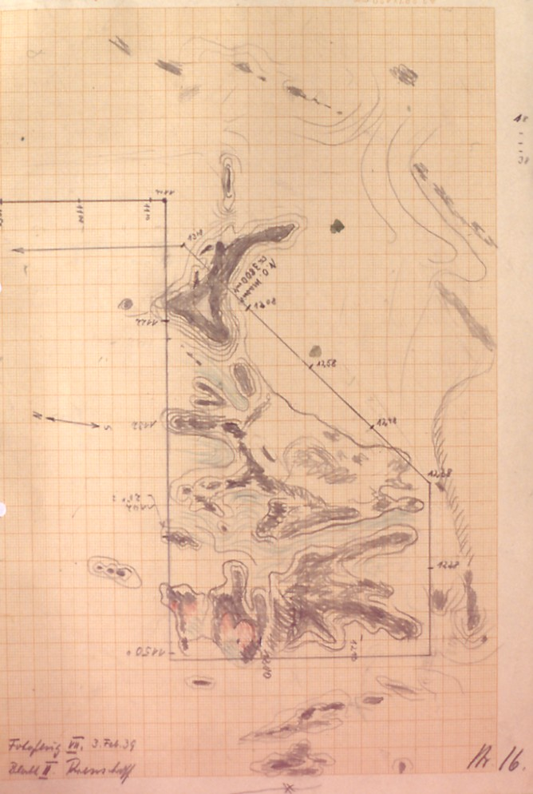
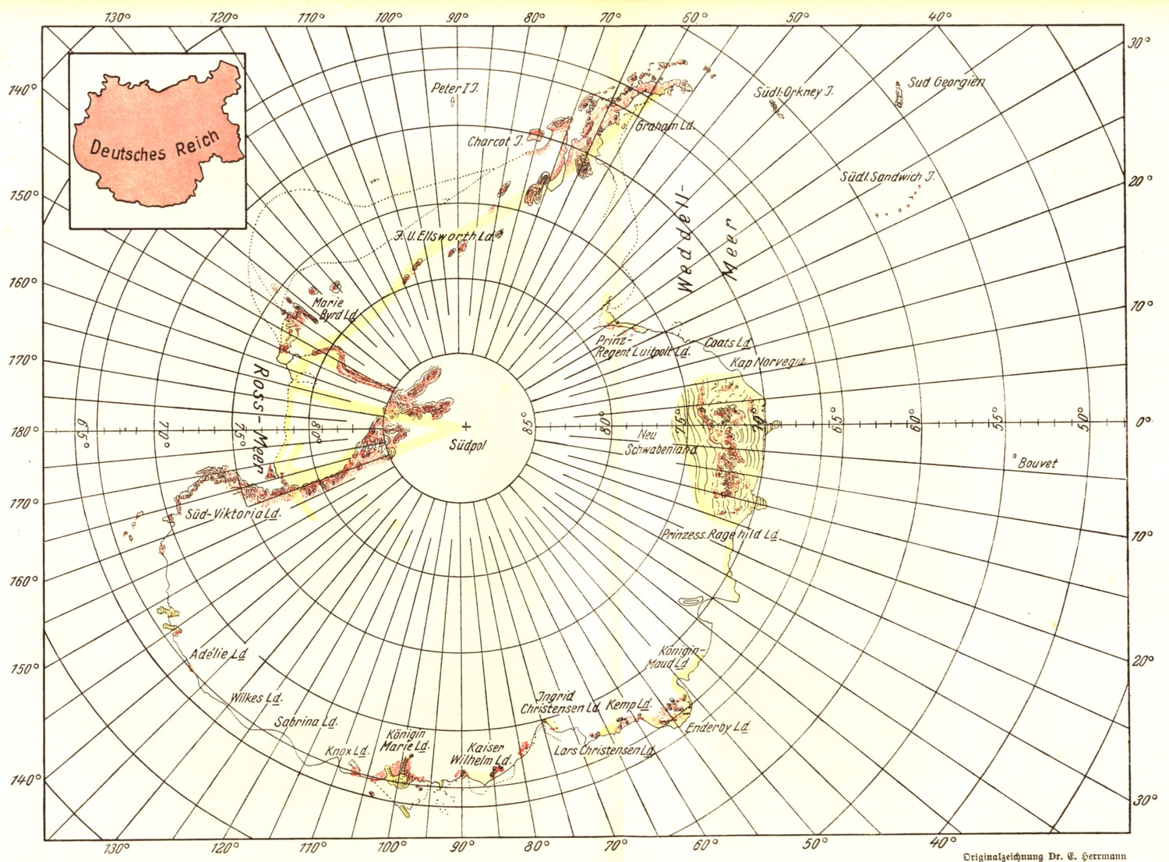
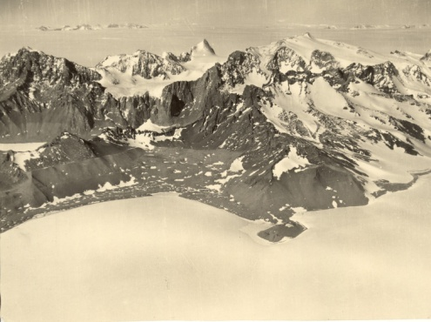
Archipelago of Spitsbergen - Svalbard
1920 1930 1940 1950 1960
Scientific expeditions for future claims
Admiral Byrd
(USA 1933-1935)
Neuschwabenland
(Germany 1938/39)
In-flight sketch 3 February 1939
1920 1930 1940 1950 1960
Antarctica
21

Slide 22
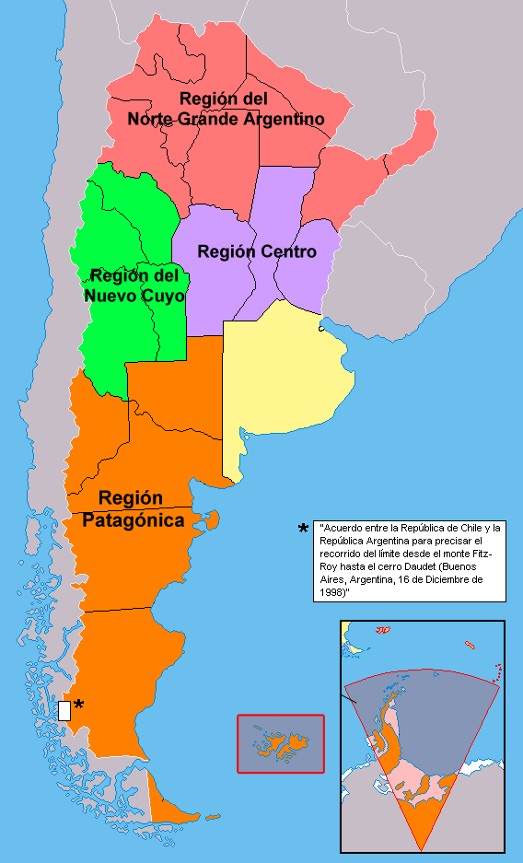
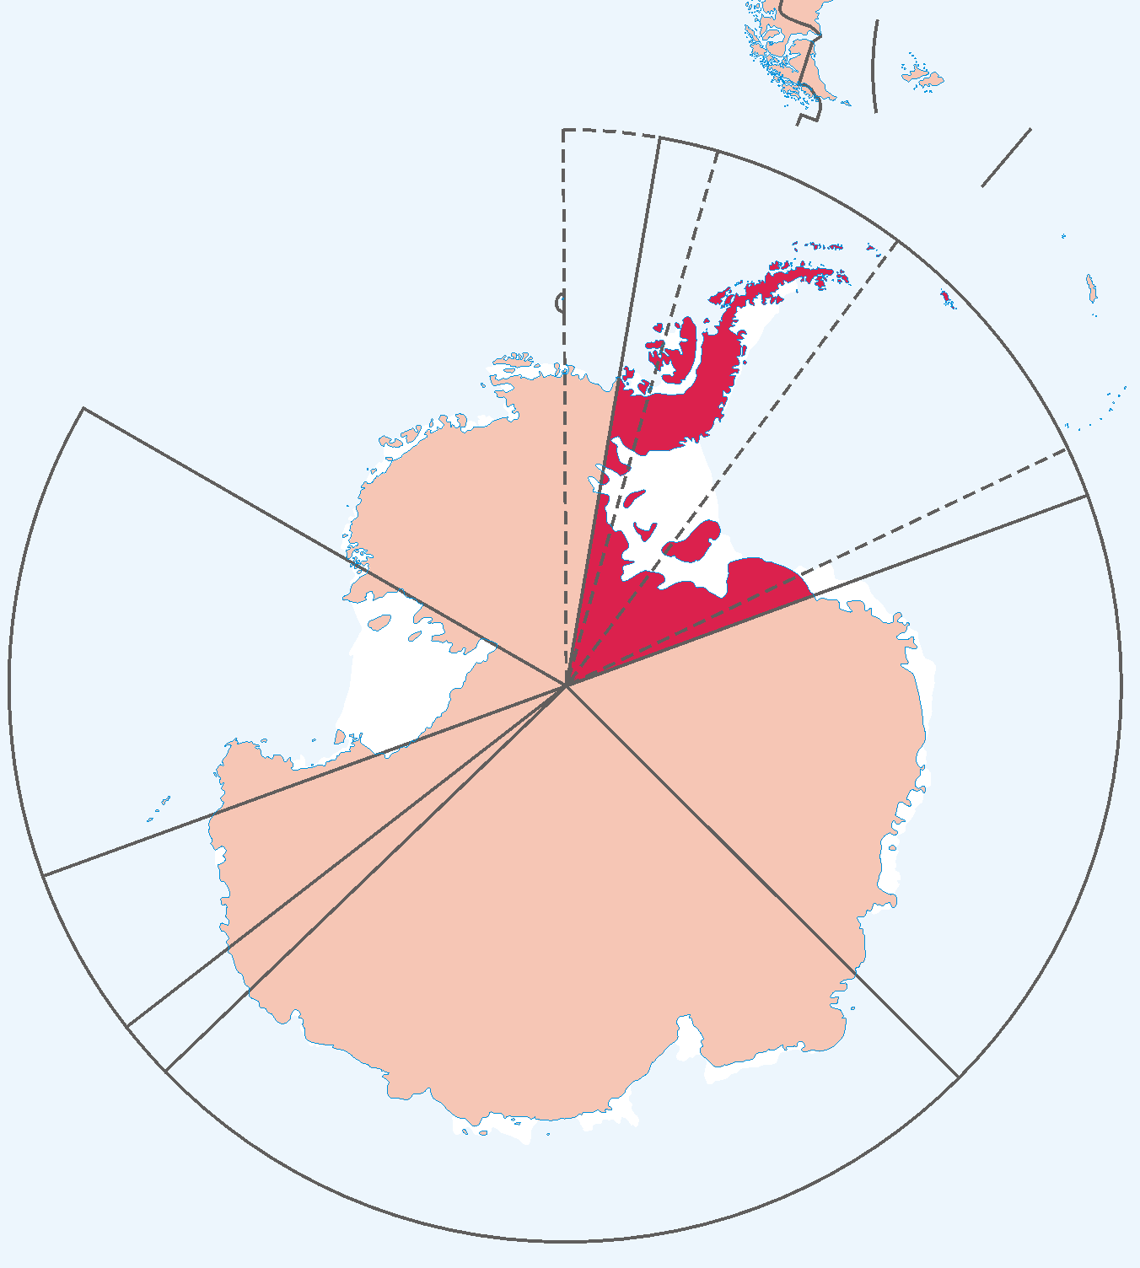
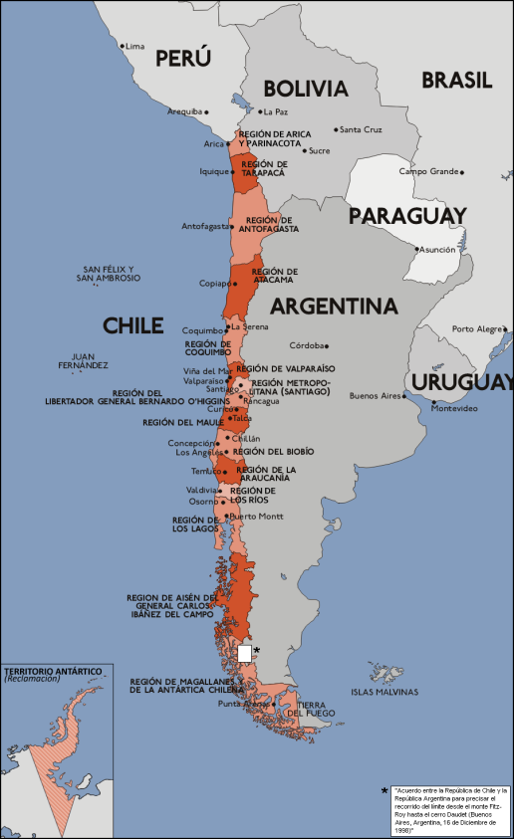
Archipelago of Spitsbergen - Svalbard
1920 1930 1940 1950 1960
1937 Argentine claim Treaty of Tordesillas of 1494
1940 Chilean claim geological argument
1943-1945
British Operation ”Tabarin”
3 Stations to preserve existing rights
ABC Problem
1920 1930 1940 1950 1960
Antarctica
22

Slide 23
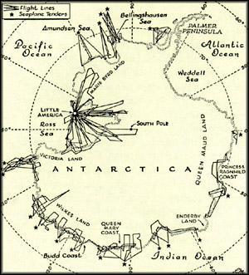
Archipelago of Spitsbergen - Svalbard
1920 1930 1940 1950 1960
United States Antarctic Development Project Operation ”High Jump”, (1946/47)
Training of 4700 soldiers
Operation “Windmill” (1947/48 )
to re-enforce possible American claims
Cold War
1920 1930 1940 1950 1960
Antarctica
23

Slide 24
Archipelago of Spitsbergen - Svalbard
1920 1930 1940 1950 1960
Secret American draft agreement on Antarctica
(Argentina, Chile, the Great Britain, the Commonwealth of Australia, New Zealand, France, and Norway, on August 9, 1948)
No territorial claims Government
”Antarctic Commission” Scientific Board
(one representative of
each state
except Soviet Union !) United international
Nations scientific bodies
Exploration and scientific investigation
Free access and freedom of transit
International peace and security
Cold War
1920 1930 1940 1950 1960
Antarctica
24

Slide 25
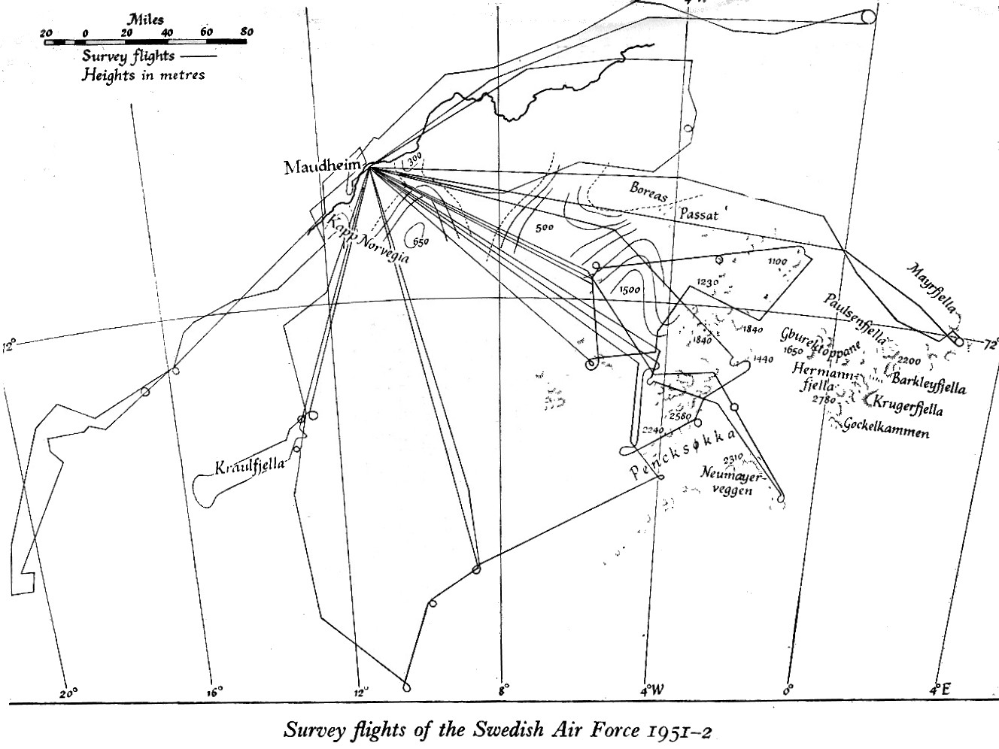
Archipelago of Spitsbergen - Svalbard
1920 1930 1940 1950 1960
Norwegian-British-Swedish-Expedition (1949-1952)
Tripartite consortium
Successful co-operation
Meteorology
Geophysics
Glaciology
Air photography
Neuschwabenland
Dronning Maud Land
Cold War
1920 1930 1940 1950 1960
Antarctica
25

Slide 26
Archipelago of Spitsbergen - Svalbard
1920 1930 1940 1950 1960
International Geophysical Year (1957-1958)
Comité Special de l'Année Geophysique Internationale
(CSAGI, founded by ICSU,1952)
World Meteorological Organisation (WMO)
Aim
Network in Antarctica (see IPC program 1905)
Ionosphere
Outer space
After IGY
Scientific Committee of Antarctic Research
(SCAR, founded by ICSU, 1958)
Cold War
1920 1930 1940 1950 1960
Antarctica
26

Slide 27
Archipelago of Spitsbergen - Svalbard
1880 1890 1900 1910 1920 1930 1940 1950 1960 1970
Mining Claims Science
2nd IPY
Mining Science
Treaty
7
Aeroarctic
2
1st IPY
International Polar Commission
ABC Problem
Antarctic Commission
1
International Met & Mag Co-operation
Treaty
IGY
Whaling Claims Science
NBSX
Science
1880 1890 1900 1910 1920 1930 1940 1950 1960 1970
Antarctica
27

